Slide 1

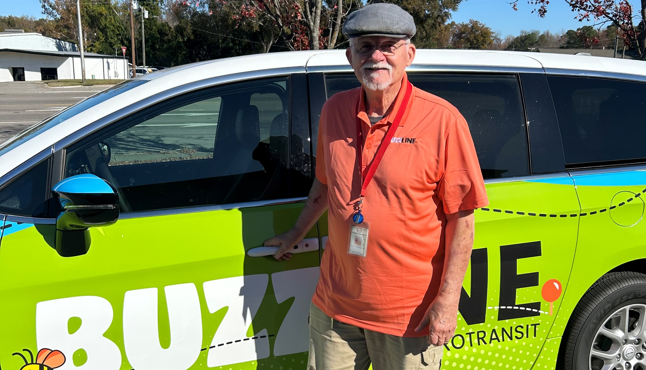
INTEGRATED MOBILITY DIVISION
Last Updated: 03/05/2026
PUBLIC TRANSPORTATION
FUNDING SOURCES
OVERVIEW
FY28

Slide 2
PUBLIC TRANSPORTATION
FUNDING SOURCES OVERVIEW
INTEGRATED MOBILITY DIVISION
Getting Started – Unified Grant Application Guidance
PART 1 – What Funding Sources are Available?
1.1 Public Transportation Funding in North Carolina
1.2 Funding Available
1.3 Additional Guidance on Available Funding
PART 2 – What Expenses are Eligible?
2.1 Using Public Transportation Funding in North Carolina
2.2 Eligible Administrative Expenses
2.3 Eligible Operating Expenses
2.4 Eligible Capital Expenses
2.5 Eligible Planning Expenses
2.6 Guidance on Identifying Reimbursable Expenses
PART 3 – Application Process & Next Steps
3.1 Unified Grant Application Process
3.2 Application Timeframes
3.3 FY28 Master Documents
3.4 Funding Program Submittals
3.5 Claim Submittals
3.6 Final Notes
Notes:
This slide outlines the content of today’s presentation
We’ll answer some important questions about Public Transportation funding in North Carolina and how it pertains to you before outlining the funding application process to get you access to the funds we’ll discuss today

Slide 3
PUBLIC TRANSPORTATION
INTEGRATED MOBILITY DIVISION
INTRO – Unified Grant Application Guidance
INTRO.1 UGA Guidance Overview
INTRO.2 How to Access the UGA Guidance
INTRO.3 New to FY28

Slide 4
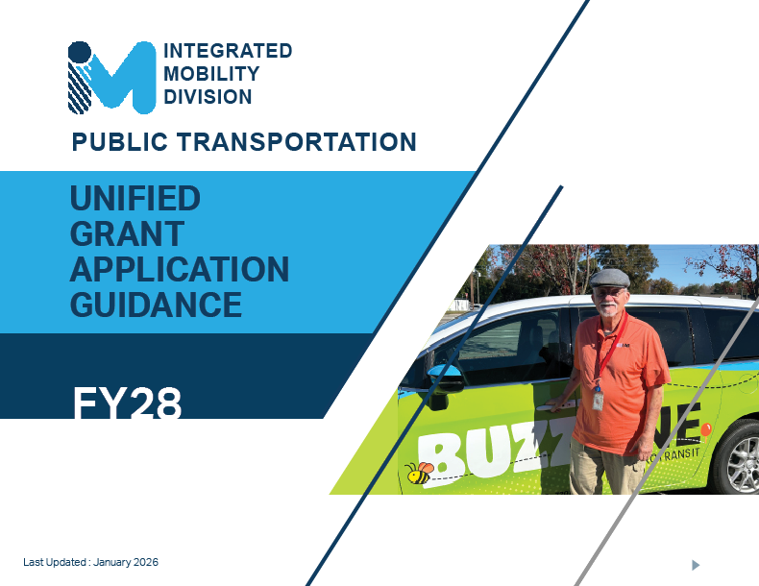
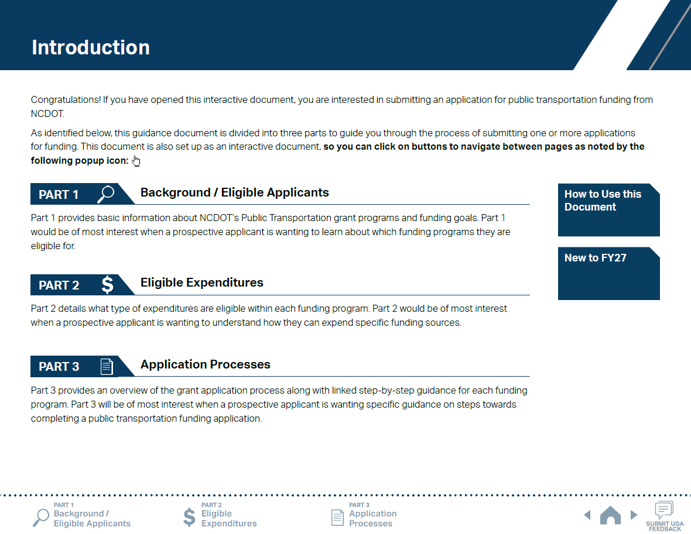
ncdot.gov
INTRO.1 UGA Guidance Overview
Notes:
Unified Grant Application is a new platform for guidance and instruction for the submittal of all public transportation grants, except specific ones such as TDM.
UGA Guidance consists of three parts just like this training material: Background/Eligible Applicants; Eligible Expenditures; and Application Processes. You will find the same information in the UGA Guidance.

Slide 5
ncdot.gov
INTRO.1 UGA Guidance Overview
What is the UGA?
The UGA is an acronym for Unified Grant Application which is a consolidated application process for nearly all transit-related grants offered through the Integrated Mobility Division (IMD).
What it Covers
The UGA Guidance document is structured into three major parts:
Part 1 – Background and Eligibility: Who can apply and what program exist.
Part 2 – Eligible Expenditures: What types of costs can be funded
Part 3 – Application Process: Step-by-step instructions for completing each program’s application
UGA Process (3 Phases)
Pre-Application: Provide preliminary documentation.
Application: Complete detailed program applications in the EBS system.
Contracting and Compliance: Agreements, compliance materials, procurement, and reporting requirements.
Notes:
[You will continue to hide the Part 0 slides – they are provided as instruction sheets for the presenter to format the slide presentation deck to align with the needs of a particular audience.]

Slide 6
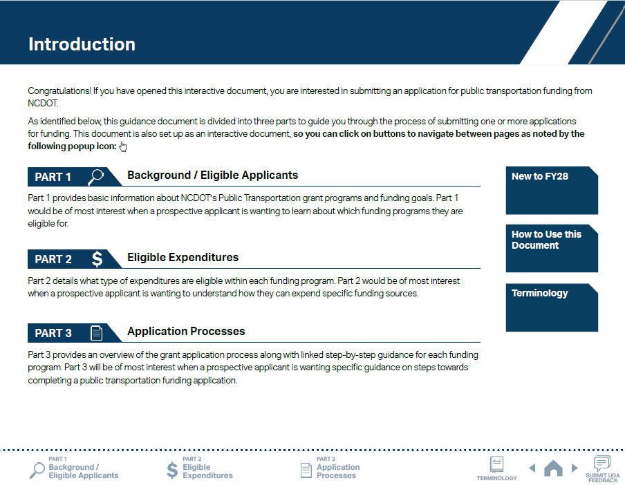
ncdot.gov
INTRO.1 UGA Guidance Overview
1
Click on icons to navigate to each part of the UGA.

Slide 7
ncdot.gov
INTRO.1 UGA Guidance Overview
1
Click on icons to navigate to each part of the UGA.
2
Use navigation buttons to view previous/next pages.

Slide 8
ncdot.gov
INTRO.1 UGA Guidance Overview
1
Click on icons to navigate to each part of the UGA.
2
Use navigation buttons to view previous/next pages.
3
Use the survey button to leave feedback.

Slide 9
ncdot.gov
INTRO.1 UGA Guidance Overview
1
Click on icons to navigate to each part of the UGA.
2
Use navigation buttons to view previous/next pages.
3
Use the survey button to leave feedback.
4
New terminology button linking to all UGA term
definitions.

Slide 10
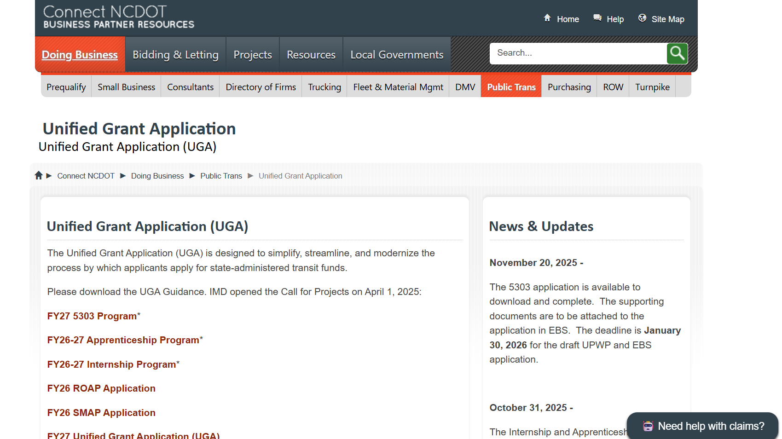
ncdot.gov
INTRO.2 How to Access the UGA Guidance
https://connect.ncdot.gov/business/Transit/Pages/Unified-Grant-Application.aspx
Notes:
UGA Guidance can be accessed through Connect NCDOT website

Slide 11
ncdot.gov
3 New to FY28
UGA Guidance Updates
Added FY28 Applicant Profile Smartsheet Form to Application Phase (Phase 2) to minimize duplicated entries of the application profile information over multiple application documents.
As per the interim final rule, references to DBE, MBE, WBE, and EEO have been removed or revised from the document. Refer to EEO Update to acknowledge the change.
The revised EEO Statement and Financial Health Statement have been added to the FY28 Pre-Application Materials Smartsheet form.
Propane conversion kits are added as a separate G-code for ordering through the Combined Capital program.
Public Hearing Notice is no longer required by state and federal regulations, but the public must be informed by other means, i.e., Facebook, Flyers, Notice on Buses.

Slide 12
ncdot.gov
3 New to FY28
UGA Guidance Updates
5311 Designee Certification Form is due for FY28 UGA Application, if applying for 5311.
The marketing fee requirement of 2% is added back into 5311 Admin G-codes G371 and G372.
Information on the IMD Internship/Apprentice Program has been added to Part 1.3 and Part 2.2. Internship/Apprentice Program has a separate application process/timeline.
Instructions on Salary & Wage Detail Report have been added to the appendix and referenced from Step 7 and Step 12 on Part 3.3.
Links to FY28 application submission workspaces for systems are now accessible through a Smartsheet table.
Fully Allocated Cost model and Cost Allocation - TBD
DOT’s Office of Civil Rights’ Unified Certification Program - TBD

Slide 13
ncdot.gov
3 New to FY28
UGA Guidance Updates
The Capital Needs Request Form is no longer a part of the UGA process. IMD will send out a separate request email with instructions.
Sample application document sets are posted on the UGA website for programs applied through the UGA process.
Removed Fax Number entries from program applications.
FTA Circular updates: 9050.1A(Info for 5339 and 5307 are combined into 9050.1A), 4220.1G, and 9040.1H
Reinstituted vehicle insurance cap amount ($4,000)

Slide 14
ncdot.gov
O
INTRO.3 New to FY26 and FY27 Refresher
FY27 UGA Updates
FY26 UGA Updates
Added new UGA documents: Capital Needs Request Form, NEPA Information Form, and Independent Cost Estimate (ICE) Form.
Smartsheet Workspaces for previous years are available to view and download for review purposes only.
Urban State Match applications are now only submitted when vehicle(s) are received.
Removed Volunteer Reimbursement from 5310 Operating Program.
The date for requesting vehicle mileage is now May 31st.
Renamed ‘Conflict of Interest Policy’ to ‘Signed Conflict of Interest Statements’.
New color scheme for Part 3.3 phases.
Added notes to the Public Hearing Notice and 5310 Capital Purchase of Service.
Consolidated application steps in Part 3.3 programs and grouped into Rural and Urban.
Removed Master Documents required for Urban grants with exception of Travelers’ Aid and ConCPT grants.
• Created a UGA Roadmap
• No cap on vehicle insurance amount (previously $2,500)
• Emphasized that sub-recipients can skip the Pre-Application Phase if they have already applied for another grant during the same fiscal year.
• Added new UGA Tools and Resources
- Smartsheet Quick Reference Guide
- UGA Video Training Materials
- UGA Progress Sheet

Slide 15
PUBLIC TRANSPORTATION
O
INTEGRATED MOBILITY DIVISION
PART 1 –
What Funding Sources are Available?
1.1 Public Transportation Funding in North Carolina
1.2 Funding Available
1.3 Additional Guidance on Available Funding
Notes:
We’ll start in Part 1 by answering the question “What funding sources are available TO ME?”

Slide 16

ncdot.gov
O
1.1 Where Transit Funding Comes From in North Carolina
Local Funds
(General Fund, Sales tax, etc.)
STATE FUNDING
Provides grants, match, and technical support
Helps systems meet federal requirements
Focuses on mobility, safety, and innovation
FEDERAL FUNDING
Largest source for many systems
Supports capital, operations, and planning
Requires reporting and compliance
LOCAL FUNDING
Fills gaps federal/state dollars don’t cover
Varies widely by county or municipality
Often determines service expansion potential
Transit Agency Budget
Notes:
Many different funding sources for all transit providers in NC
Rarely is only one funding source used, often a combination
Each funding source may have its own rules on eligibility and applicability; when combined, all rules must be met
This makes for a slightly nuanced discussion on public transportation funding

Slide 17


ncdot.gov
O
1.2 Funding Available
Depending on the funding program, particular funding amounts determined by:
Formula
Need
Other*
(STI, TDM, etc.)
(A+B) x C =
*Discretionary funding (such as AIM, etc.) sources also available under “Other”. Requirements/application process different for each program but typically require submittals through EBS.
Notes:
Depending on the funding program, particular funding amounts determined by either:
Formula – Most of our largest public transportation funding sources are determined by a federal or state funding formula (determined by legislation or policy); the formula is typically a calculation that incorporates metrics on the population served
Need – A few funding sources are distributed based on need as determined by detailed evidence provided through the application process (applicants should be deliberate and fully explain their need for the greatest chance at the greatest funding amount!)
Other – Still other programs are determined outside of the Call Projects purview such as the STI-related funds that are determined through the statewide prioritization process coordinated through MPOs, RPOs, and NCDOT Division Engineers

Slide 18
ncdot.gov
O
1.2 Funding Available
5303
5310 Capital Purchase of Service
5310 Operating
5311 Admin/Operating
Urban Advanced Technology
Urban Strategic Transportation Investments (STI)
Rural STI
Combined Capital
ConCPT Consolidation (CN)
ConCPT Coordination (CO)
Rural State Operating Funds (RO)
Rural Operating Assistance Program (ROAP)
State Maintenance Assistance Program (SMAP)
Transportation Demand Management (TDM)
Travelers’ Aid
Urban State Match
Non-STI
Mobility Manager
Capital Cost of Contracting
Internship/Apprentice Program
Notes:
Here is the list of funding programs available in FY27.
Your organization may not be eligible for some of the funding programs.
The following slides demonstrate which funding programs you can apply for.

Slide 19
ncdot.gov
1.3 UGA Eligibility Summary Table
PROGRAM
ELIGIBILITY USE
LOCAL MATCH
5303 Metropolitan Planning | Planning Activities | 10%
5310 Capital Purchase of Service | Purchase of Transportation Services | 20% if no state funds
5310 Operating | Transit for Seniors & Disabled | 50% Operating
5311 Rural Operating / Admin | Operating & Admin Costs | 15% Operating 20% Cap.
Urban Advanced Technology | Technology Projects | Varies
Urban STI | Capital Projects (STI) | 10%
Rural STI | Rural Capital Projects | 10%
Combined Capital | Vehicles, Facilities, Equipment | 20% if no state funds
ConCPT Consolidation (CN) | System Consolidation | 5%
ConCPT Coordination (CO) | Coordinated Services | 50%
Rural State Operating (RO) | Operating Assistance | 50%
ROAP | Elderly, Employment, Rural Trips | 0%
SMAP | State Operating Assistance | 50%
TDM | Commuter Options, TDM Activities | 50%
Travelers' Aid | Outreach and Assistance | 50%
Urban State Match | Urban Transit Projects | Varies
Non-STI Rural Expansion Vehicle | Vehicle Expansion | 20%
Mobility Manager | Mobility Coordination Programs | 20% if no state funds
Capital Cost of Contracting | Contracted Transportation Services | 20%
Internship/Apprentice | Financial Assistance for Interns and Apprentices | 10%
Color Key
= Federal Programs
= State Programs

Slide 20
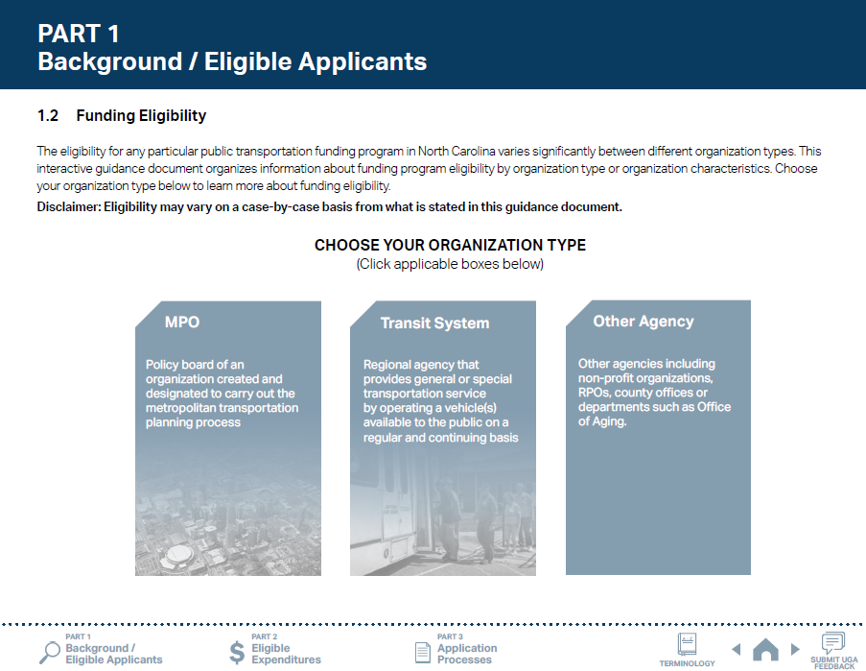
ncdot.gov
1.3 Additional Guidance on Available Funding
1
Choose your organization type.
Notes:
For more information about the funding availability, please refer to Part 1.2 of the UGA Guidance.
The main page of the Part 1.2 provides hyperlinks to each organization type.
If you click the MPO box, you will see a brief summary of programs that your MPO is eligible for.

Slide 21
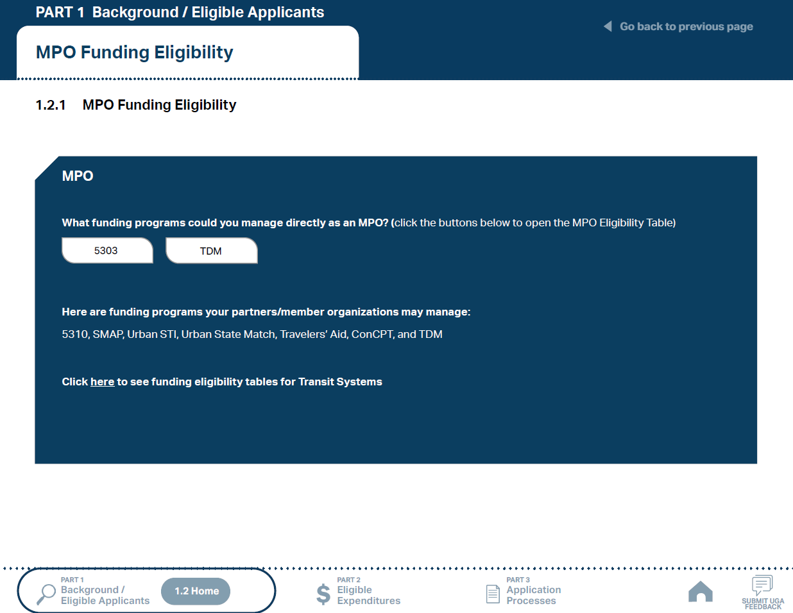

ncdot.gov
1.3 Additional Guidance on Available Funding
1
Choose your organization type.
2
Click the funding programs to see the eligibility table.
Notes:
If you click a funding program box, then you will see funding eligibility and split information.

Slide 22
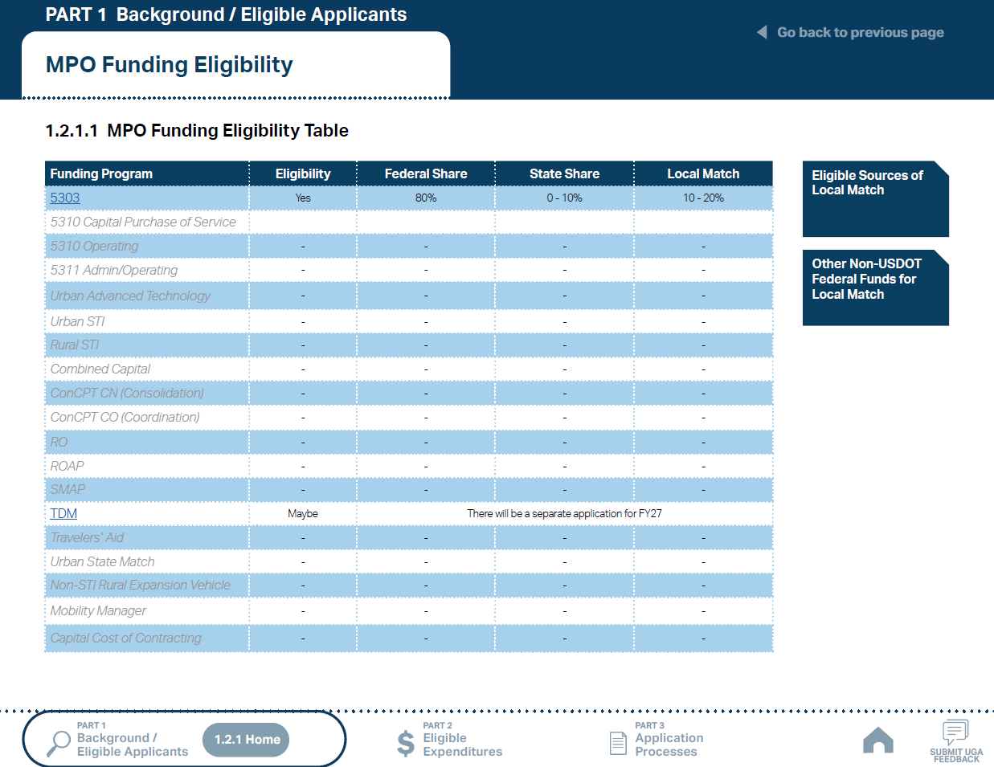
ncdot.gov
1.3 Additional Guidance on Available Funding
1
Choose your organization type.
2
Click the funding programs to see the eligibility table.
3
Check the eligibility for each program. Click the boxes to the right of the table for more instructions.
Notes:
In this example, MPOs are eligible for 5303 and TDM funding programs.
The “Eligible Sources of Local Match” and “Other Non-USDOT Federal Funds for Local Match” are links that provide additional information related to funding.

Slide 23
ncdot.gov
1.3 Additional Guidance on Available Funding
1
Choose your organization type.
2
Click the funding programs to see the eligibility table.
3
Check the eligibility for each program. Click the boxes to the right of the table for more instructions.
4
Use the navigation box to go back to Part 1 or 1.2.1 Home.

Slide 24

ncdot.gov
1.3 Additional Guidance on Available Funding
1
Choose your organization type.
Notes:
For more information about the funding availability, please refer to Part 1.2 of the UGA Guidance.
The main page of the Part 1.2 provides hyperlinks to each organization type.
If you click the Transit System box, you will see a list of all transit systems in North Carolina.

Slide 25
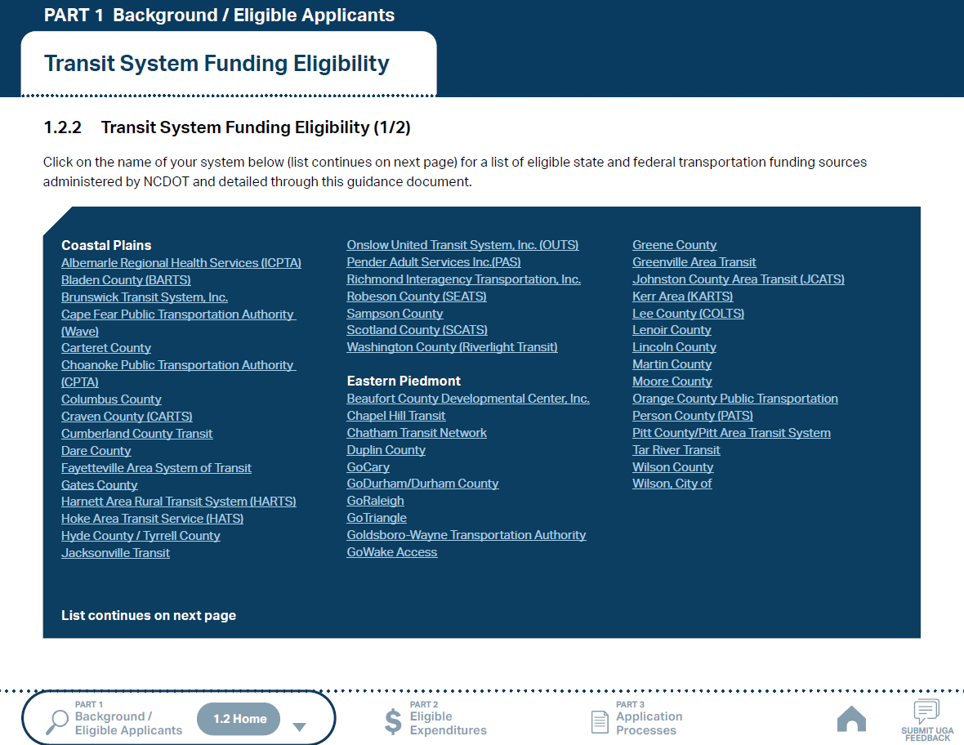
ncdot.gov
1.3 Additional Guidance on Available Funding
1
Choose your organization type.
2
Click the name of your system to see the eligibility table.
Notes:
You can click on your system name to see the funding eligibility/split table for your system.

Slide 26
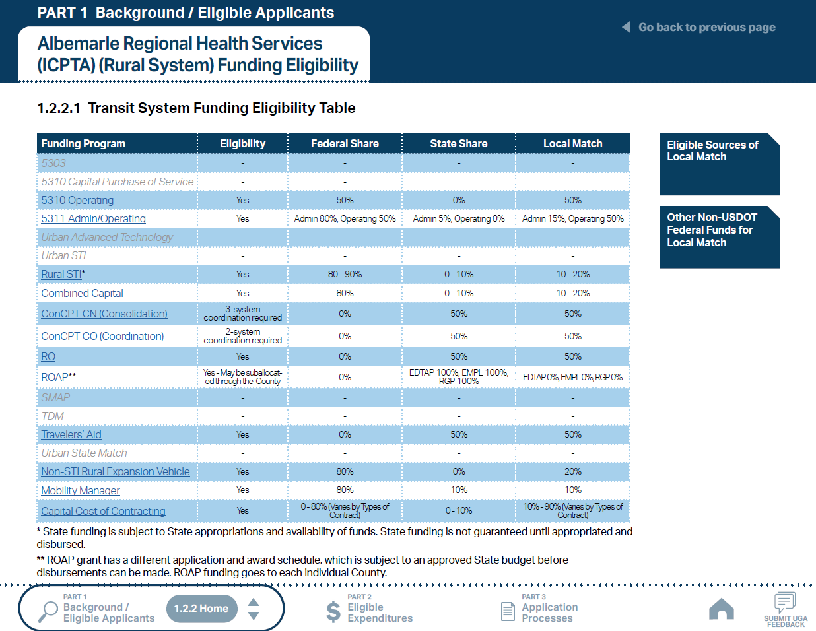
ncdot.gov
1.3 Additional Guidance on Available Funding
1
Choose your organization type.
2
Click the name of your system to see the eligibility table.
3
Check the eligibility for each program. Click the boxes to the right of the table for more instructions.
Notes:
This table shows which funding programs are eligible for your system and the funding split information for each funding program.
The “Eligible Sources of Local Match” and “Other Non-USDOT Federal Funds for Local Match” are links that provide additional information related to funding.

Slide 27
ncdot.gov
1.3 Additional Guidance on Available Funding
1
Choose your organization type.
2
Click the name of your system to see the eligibility table.
3
Check the eligibility for each program. Click the boxes to the right of the table for more instructions.
4
Use the navigation box to go back to Part 1 or 1.2.2 Home.

Slide 28
ncdot.gov
1.3 Additional Guidance on Available Funding
1
Choose your organization type.
Notes:
For more information about the funding availability, please refer to Part 1.2 of the UGA Guidance.
The main page of the Part 1.2 provides hyperlinks to each organization type.
If you click the County Government box, you will see a brief summary of programs that your County is eligible for.

Slide 29
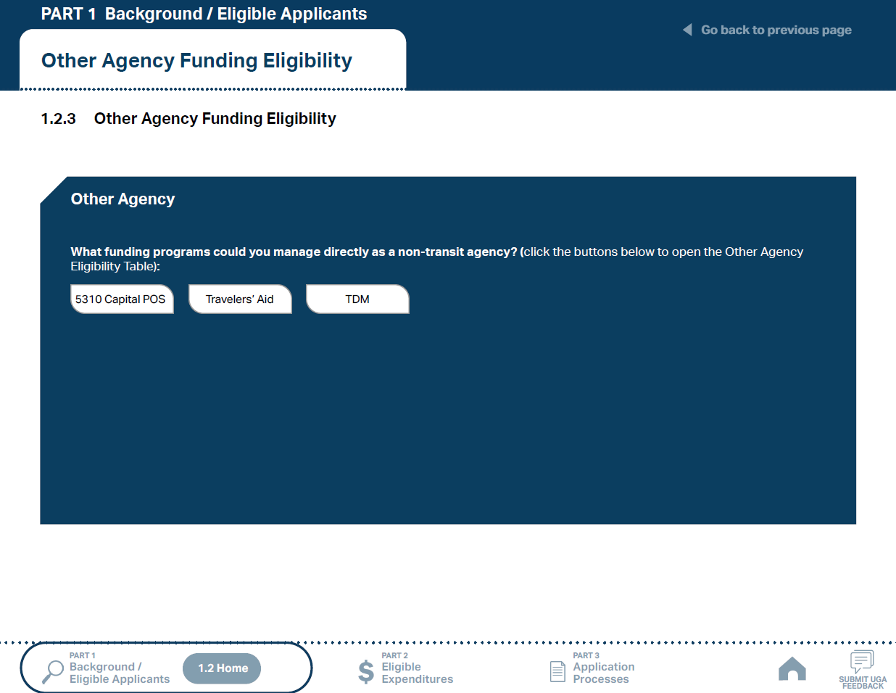
ncdot.gov
1.3 Additional Guidance on Available Funding
1
Choose your organization type.
2
Click the funding programs to see the eligibility table.
Notes:
If you click a funding program box, then you will see funding eligibility and split information.

Slide 30

ncdot.gov
1.3 Additional Guidance on Available Funding
1
Choose your organization type.
2
Click the funding programs to see the eligibility table.
3
Check the eligibility for each program. Click the boxes to the right of the table for more instructions.
Notes:
In this example, Other Agencies are eligible for Capital – Purchase of Service, TDM, and Travelers’ Aid funding programs.
The “Eligible Sources of Local Match” and “Other Non-USDOT Federal Funds for Local Match” are links that provide additional information related to funding.

Slide 31
ncdot.gov
1.3 Additional Guidance on Available Funding
1
Choose your organization type.
2
Click the funding programs to see the eligibility table.
3
Check the eligibility for each program. Click the boxes to the right of the table for more instructions.
4
Use the navigation box to go back to Part 1 or 1.2.3 Home.

Slide 32
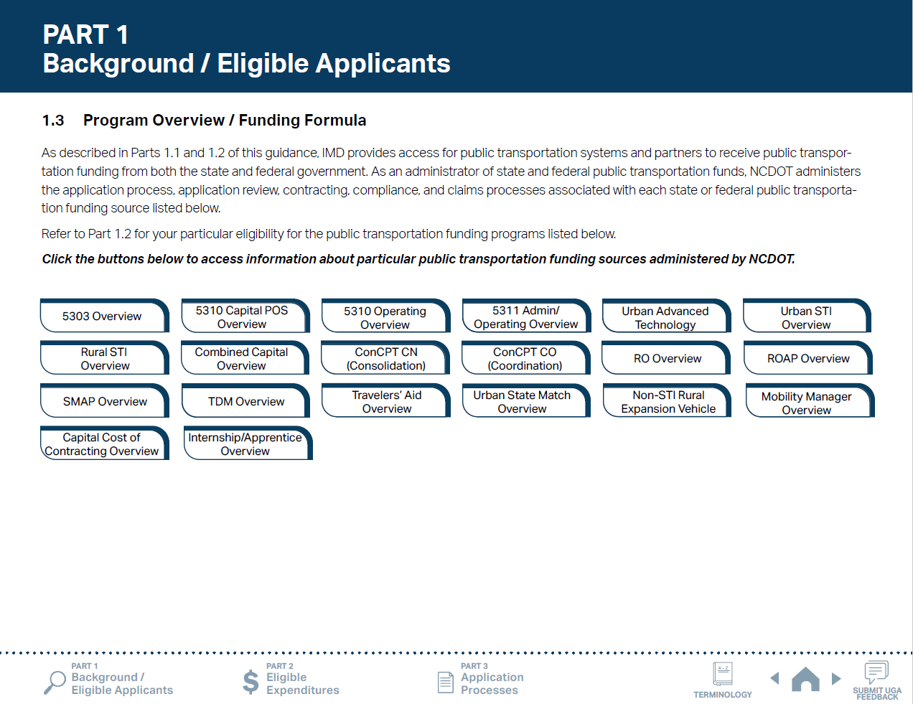
ncdot.gov
1.3 Additional Guidance on Available Funding
1
Click the program of your interest.
Notes:
For additional information about funding programs, you can refer to Part 1.3 of the UGA Guidance.
Click on one of buttons to see your program of interest.

Slide 33
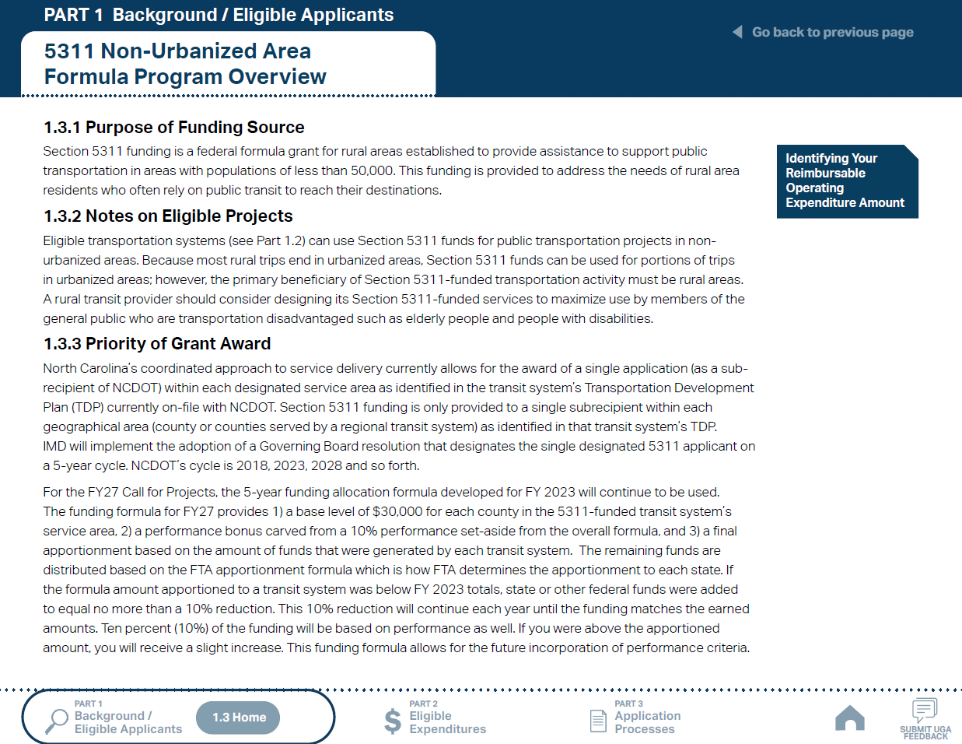
ncdot.gov
ncdot.gov
O
1.3 Additional Guidance on Available Funding
1
Click the program of your interest.
2
Click boxes to the right to see more instructions.
Notes:
Each page provides additional information on the funding source, including its purpose, eligible projects, and priority of the grant award.

Slide 34
ncdot.gov
1.3 Additional Guidance on Available Funding
1
Click the program of your interest.
2
Click boxes to the right to see more instructions.
3
Use navigation box to go back to Part 1 or 1.3 Home.

Slide 35
PUBLIC TRANSPORTATION
INTEGRATED MOBILITY DIVISION
PART 2 –
What Expenses are Eligible?
2.1 Using Public Transportation Funding in North Carolina
2.2 Eligible Administrative Expenses
2.3 Eligible Operating Expenses
2.4 Eligible Capital Expenses
2.5 Eligible Planning Expenses for
2.6 Guidance on Identifying Reimbursable Expenses
Notes:
After reviewing which funding sources you are eligible for, we will move on to discuss how you can spend those funds appropriately in order to get reimbursed

Slide 36
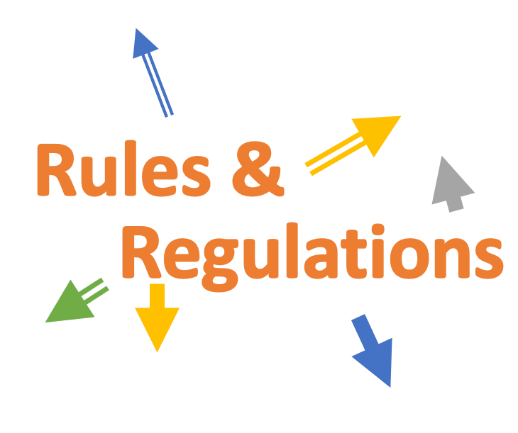
ncdot.gov
2.1 Using Public Transportation Funding in North Carolina
Different Rules for Different Funds
Reimbursement Basis
Local Match
Notes:
Complex picture for funding rules in NC
If any federal or state funding is used, you need to know three basic/overarching drivers:
Funds are provided on a reimbursement basis (have your own funding ready to spend and expect to be partially reimbursed)
10-50% local match is almost always required when accessing state or federal funds
Each funding source used has different rules. As a special note - compliance is important and you MUST follow rules to remain IN compliance to access funds

Slide 37
ncdot.gov
2.1 Reimbursement Basis
Claim
Reimbursement
*Taxes are not usually reimbursable
Notes:
Accessing funds that are provided through a reimbursement basis means that you have to pay your invoice first before submitting claims to be reimbursed (partially)
Be ready to bring your money to the table for grants!
As a special note, taxes are not usually reimbursable

Slide 38
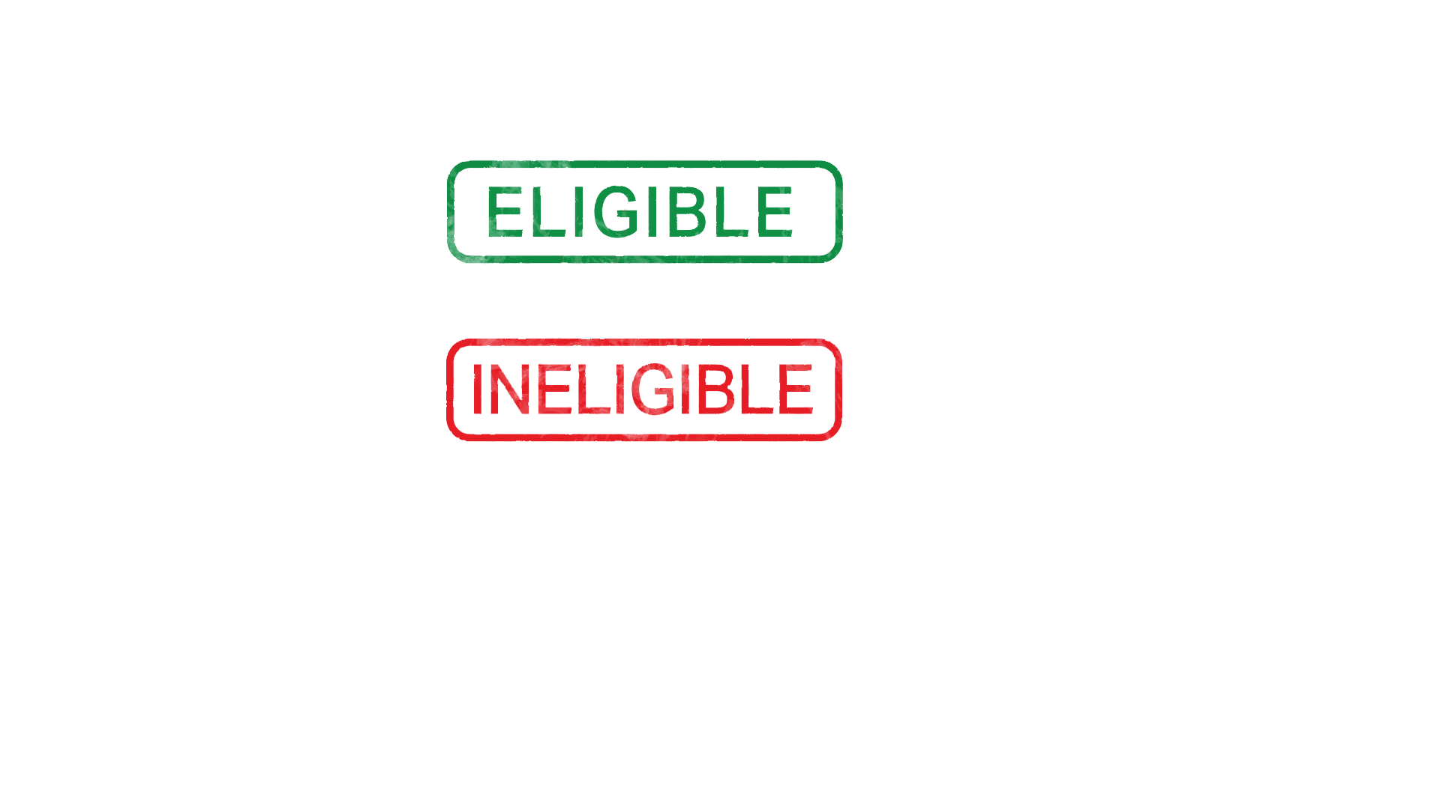
ncdot.gov
2.1 Local Match
Eligible Sources
Ineligible Sources
Notes:
Also, a local match is almost always required to access reimbursable funds
Be careful when identifying local match sources because some funds are not eligible as a local match

Slide 39
ncdot.gov
2.1 Local Match
Eligible Sources
Local or state appropriations
Dedicated tax revenues
Federal funds – non-USDOT – must have transportation component (employment training, aging, community services, vocational rehabilitation, etc.)
Private donations
Revenue from human services contracts and net income generated from advertising and concessions
NOTE: Applicants should be prepared for the entire Local Share amount in the event State funding is not available.
Notes:
Here are some example eligible match sources

Slide 40
ncdot.gov
2.1 Local Match
Ineligible Sources
Farebox revenue
Federal USDOT funds (when matching federal)
NOTE: Applicants should be prepared for the entire Local Share amount in the event State funding is not available.
Notes:
Here are some notes on sources that are not eligible as a local matching source

Slide 41
ncdot.gov
2.1 Different Rules for Different Funds
Rules &
Regulations
Notes:
When utilizing multiple different funding sources for your agency’s public transportation budgets, be aware that different rules apply for each funding source
Note that you will have a different path for each of the different funding sources you will use. This includes a different path with different rules for each fund for:
Application for funding
Document submittal to support a funding application
Compliance after award of funds
And Claim Submission for reimbursement after award
Note in particular that compliance rules vary for different funds, and this is sometimes overlooked by grant recipients
Now let’s take a look at some funding source rules by category:

Slide 42
ncdot.gov
2.2 Eligible Administrative Expenses
Salaries/Fringe
Office Supplies
5311 Admin/
Operating
TDM
5311 Admin/
Operating
TDM
Mobility
Mgmt
Mobility
Mgmt
Vehicle Insurance
Marketing
5311 Admin/
Operating
5311 Admin/
Operating
TDM
*Marketing/advertising not an eligible Mobility Manager expense
Notes:
[REVISE this slide to show only applicable funding sources for your audience – delete circle graphics for funds that are not shown in your audience’s revised part 1.2 slide(s)]
This slide highlights how you might use your funding sources for eligible expenses
Note that Mobility Manager is considered a capital fund with a 50% local match, but it can be used for these administrative expenditures

Slide 43
ncdot.gov
2.3 Eligible Operating Expenses
Public Transportation Trips
5311 Admin/
Operating
5310
Operating
ConCPT
RO
ROAP
SMAP
Notes:
[REVISE this slide to show only applicable funding sources for your audience – delete circle graphics for funds that are not shown in your audience’s revised part 1.2 slide(s)]
This slide highlights how you might use your funding sources for eligible expenses.
5310 – Operating, Capital Purchase of Service, and Mobility Manager grant applications must show the detail of how the amount of the grant request is derived (i.e. number of trips anticipated at trip cost, trip cost developed; i.e., by Fully Allocated Cost model or some other cost pricing method)
ROAP & SMAP have a table of trip-types that can be performed with these funds. Unlike other funds highlighted on this slide, these funds are not reimbursed but provided after grant award with a requirement for ROAP recipients to report trips biannually

Slide 44
ncdot.gov
2.4 Eligible Capital Expenses
Purchase/Replacements of Vehicle
Facility Acquisition and Improvements
Combined Capital
STI
Urban State Match
Combined Capital
Urban State Match
New Construction and Land Purchase
Other Equipment
Combined Capital
STI
Urban State Match
Combined Capital
Urban Advanced Technology
Notes:
[REVISE this slide to show only applicable funding sources for your audience – delete circle graphics for funds that are not shown in your audience’s revised part 1.2 slide(s)]
This slide highlights how you might use your funding sources for eligible expenses
Vehicles must reach useful life by June 30th of the applicable year to be eligible for replacement.
Useful life mileage for most vehicles matches federal levels outlined in Circular 5010.E, i.e., Center Aisle Vans, mini-van, conversion van – 100,000 miles, Bus: LTVs 20-28’ – 100,000 miles, All larger bus thresholds remain the same
5310 – Operating, Capital Purchase of Service, and Mobility Manager grant applications must show the detail of how the amount of the grant request is derived (i.e. number of trips anticipated at trip cost, trip cost developed; i.e., by Fully Allocated Cost model or some other cost pricing method)

Slide 45
ncdot.gov
2.4 Eligible Capital Expenses
Direct Purchase of Service - 5310
Expansion for Motor Vehicles
5310 Capital
Purchase of Service
Non-STI Rural Expansion
STI
User Subsidy
Office Furniture & Computers
Travelers' Aid
Combined Capital
Contracting
Capital
Cost of Contracting
Notes:
[REVISE this slide to show only applicable funding sources for your audience – delete circle graphics for funds that are not shown in your audience’s revised part 1.2 slide(s)]
(Examples continued from previous slide)
Non-STI Rural Expansion Vehicles fund is for vehicle expansion desires only. Potential for expansion vehicles if federal funds are available and applicant can budget for the 20% local share (no state funds). Funding is not guaranteed

Slide 46
ncdot.gov
2.5 Eligible Planning Expenses
Long-term/Short-term Transportation Plan
Transportation Improvement Program
5303
5303
Transit System Management
Other Activities
5303
5303
Notes:
This slide highlights how you might use your funding sources for eligible expenses, in coordination with your MPO as applicable

Slide 47
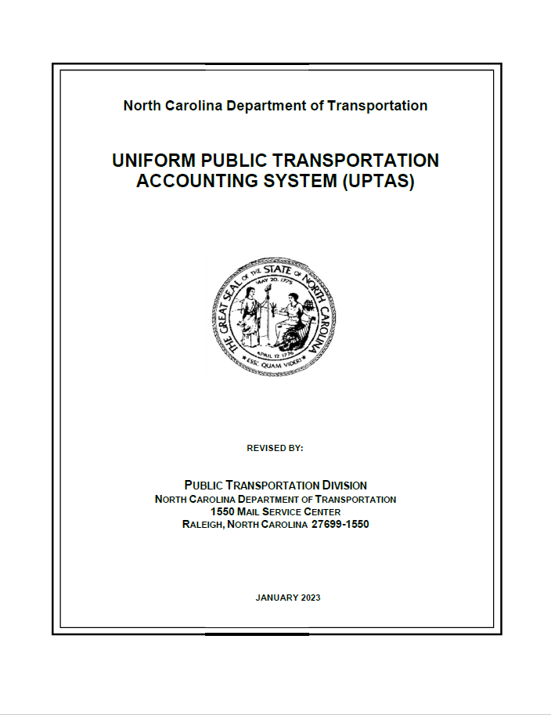
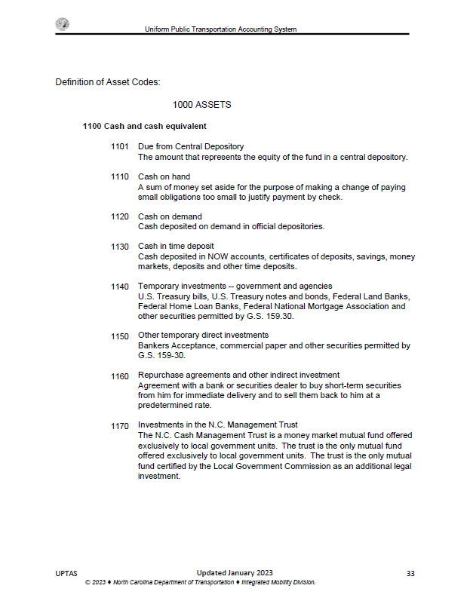
ncdot.gov
2.6 Guidance on Identifying Reimbursable Expenses
Uniform Public Transportation Accounting System (UPTAS)
Notes:
A UPTAS is available for specific guidance on accounting codes and uses of those codes for desired expenses

Slide 48
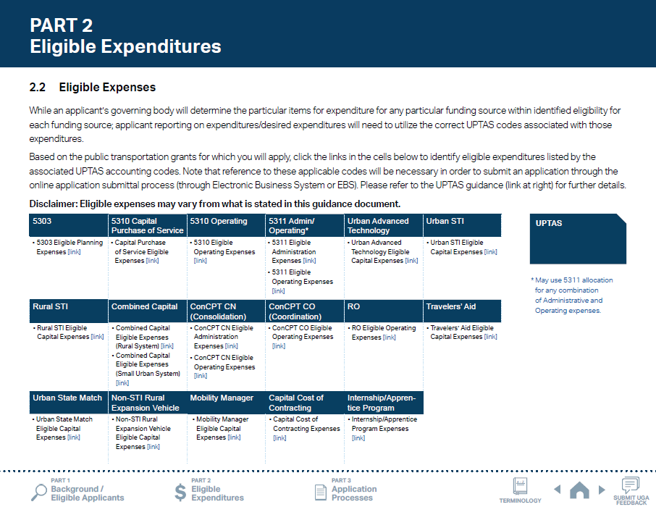
ncdot.gov
2.6 Guidance on Identifying Reimbursable Expenses
1
Click on one of the hyperlinks in the table to see the program-specific eligible expenditure.
Notes:
Part 2.2 of the UGA Guidance will walk you through which expenses are eligible for each funding program.
Click on one of the hyperlinks in the table to see the program-specific eligible expenditure with G-codes or M-codes.

Slide 49
ncdot.gov
2.6 Guidance on Identifying Reimbursable Expenses
1
Click on one of the hyperlinks in the table to see the program-specific eligible expenditure.
2
Click the box to the right to see the UPTAS document.

Slide 50
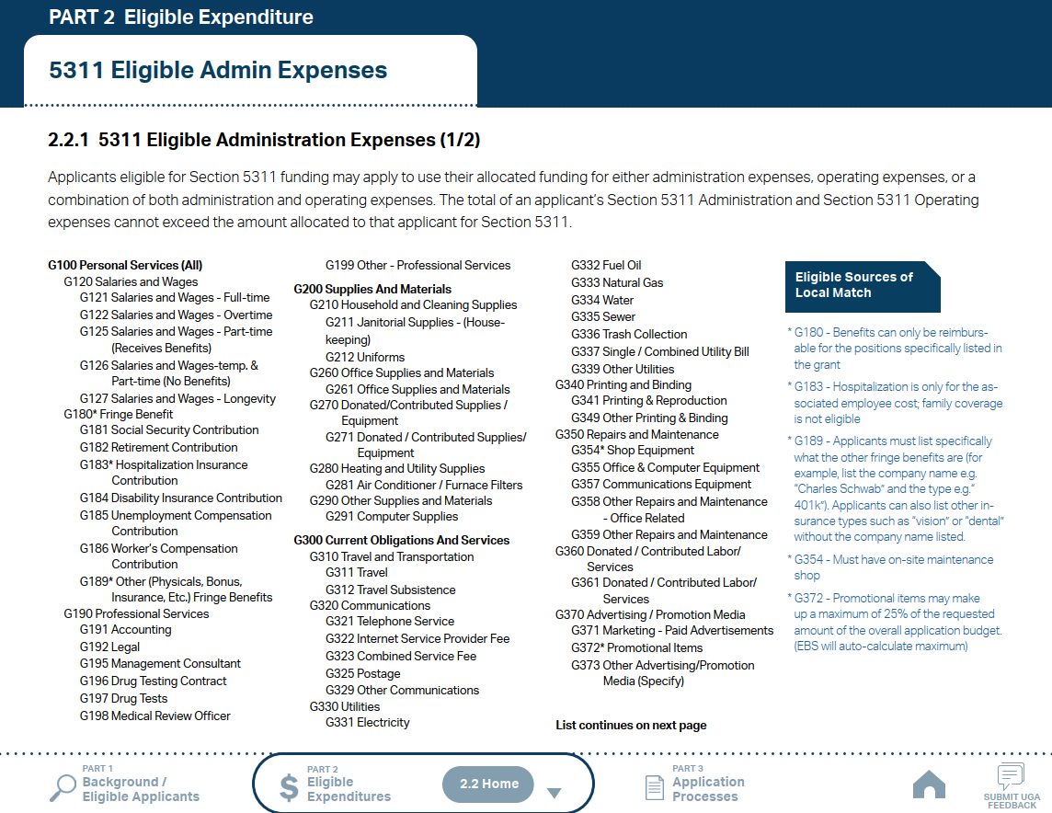
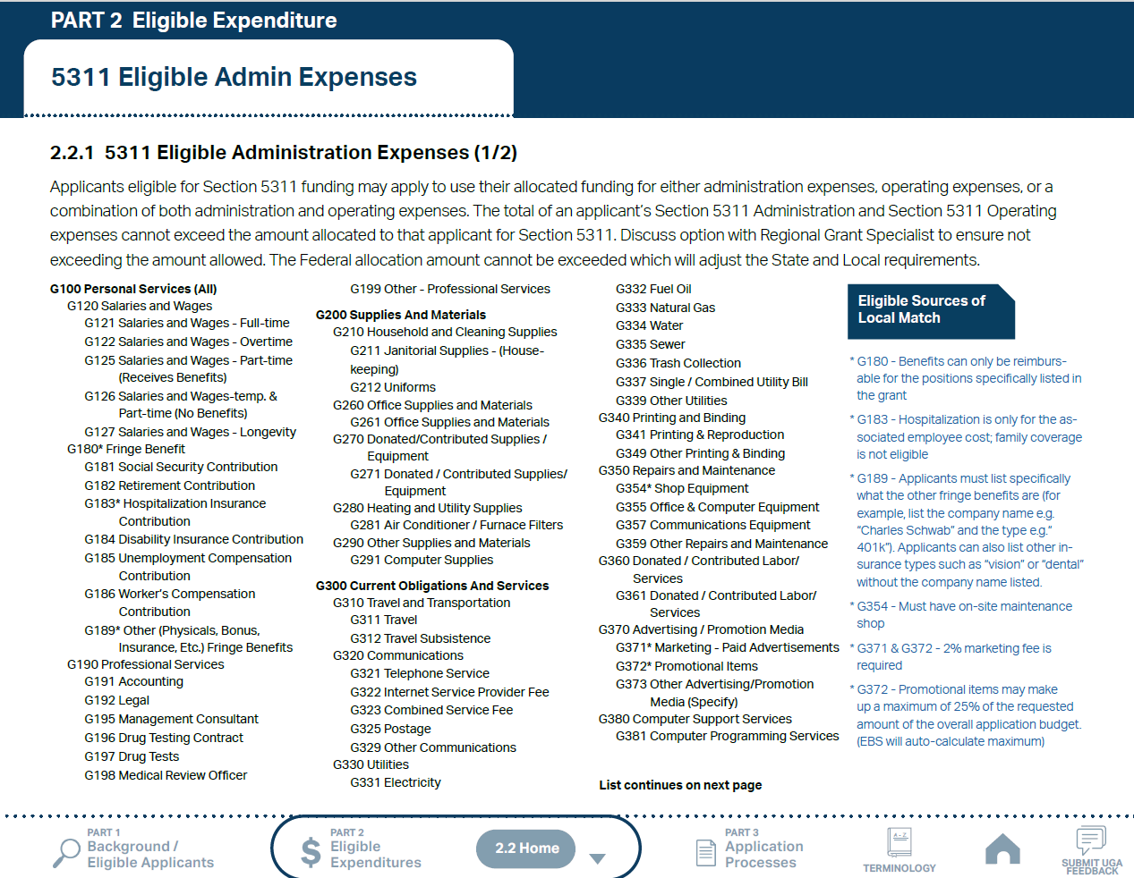
ncdot.gov
2.6 Guidance on Identifying Reimbursable Expenses
1
Click on one of the hyperlinks in the table to see the program-specific eligible expenditure.
2
Click the box to the right to see the UPTAS document.
3
Check the eligible expenses for each program. Click the boxes to the right to see more instructions.
Notes:
Please note that some expenses may have special restrictions.

Slide 51
ncdot.gov
2.6 Guidance on Identifying Reimbursable Expenses
1
Click on one of the hyperlinks in the table to see the program-specific eligible expenditure.
2
Click the box to the right to see the UPTAS document.
3
Check the eligible expenses for each program. Click the boxes to the right to see more instructions.
4
Use navigation box to go back to Part 2 or 2.2 Home.

Slide 52
PUBLIC TRANSPORTATION
INTEGRATED MOBILITY DIVISION
PART 3 –
Application Process & Next Steps
3.1 Application Timeframes
3.2 Unified Grant Application Process
3.3 FY28 Master Documents
3.4 Funding Program Submittals
3.5 Claim Submittals
3.6 Final Notes
Notes:
After understanding how various funding sources can be used towards implementing public transportation in North Carolina, let’s talk about how you can access those funds to make it happen!

Slide 53
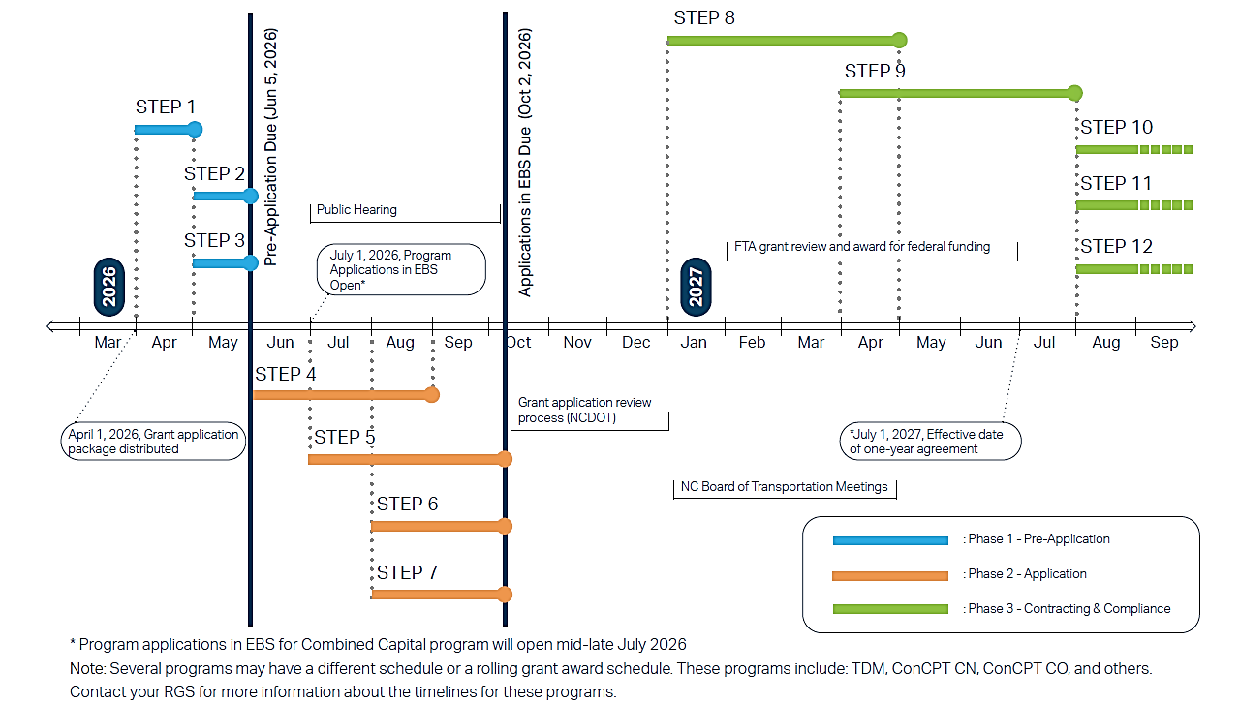
ncdot.gov
ncdot.gov
O
3.1 Application Timeframes
Notes:
Here’s an outline of the grant application timeframe for the coming year:
The Pre-Application Phase opens in April 2026
Pre-Application due on June 5th
Grant Applications due on October 2nd
Federal certs and assurances will be distributed for your confirmation and return to NCDOT between January and April 2027
Agreement processes for funded applications expected between April and July 2027

Slide 54
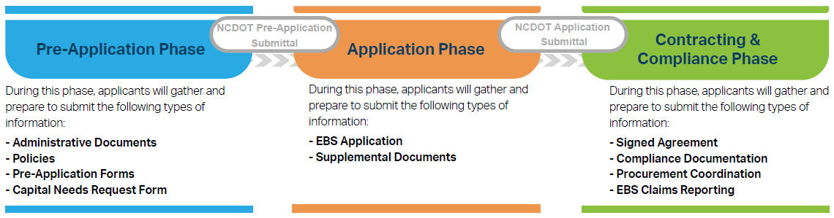
ncdot.gov
3.2 Unified Grant Application Process
Note: you can skip the Pre-Application Phase if you are only applying for Urban Advanced Technology, Urban STI, or Urban State Match.
Notes:
Unified Grant Application Process consists of three phases.
Pre-Application Phase begins with completing a Pre-Application Registration Form. You will submit supplemental documents that don’t require any funding decision.
During the Application Phase, you can submit all remaining application documents through EBS dropbox.
After you submit EBS funding application, you can proceed to work on contracting & compliance documents.

Slide 55
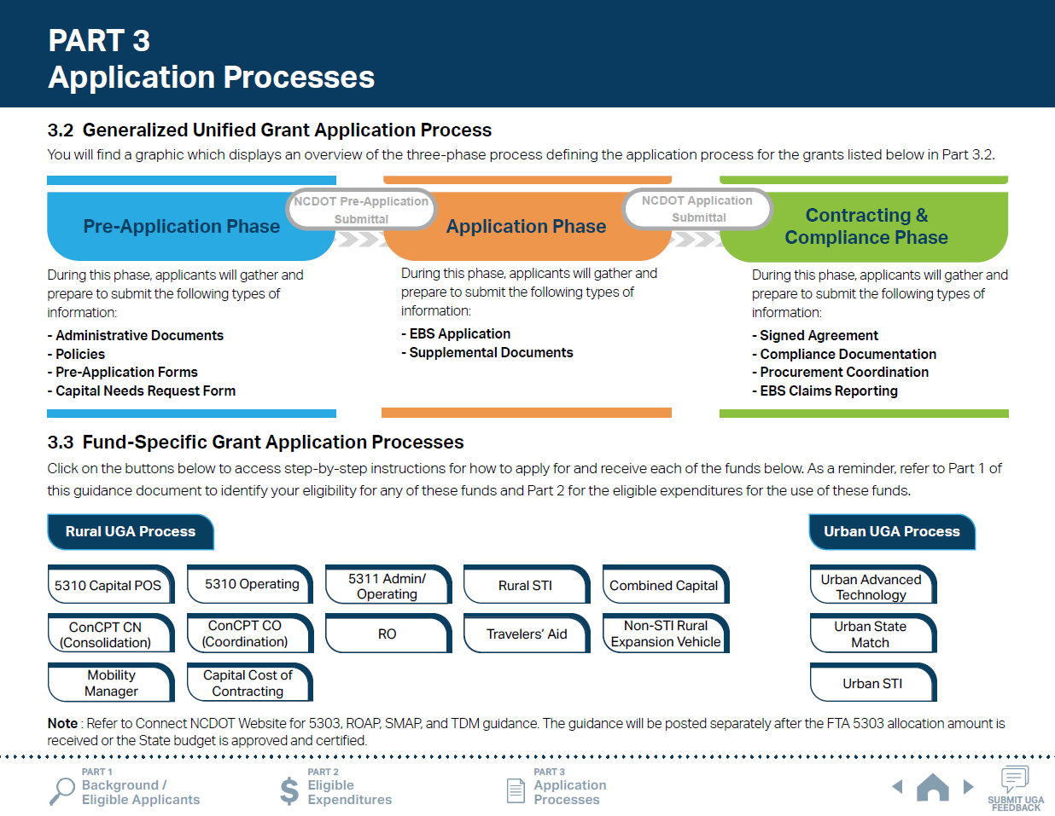
ncdot.gov
3.2 Unified Grant Application Process
1
Click funding program names to check program specific step-by-step instructions.
Notes:
You can check program specific step-by-step instructions by clicking funding program names under the Part 3.3 of the UGA Guidance.

Slide 56
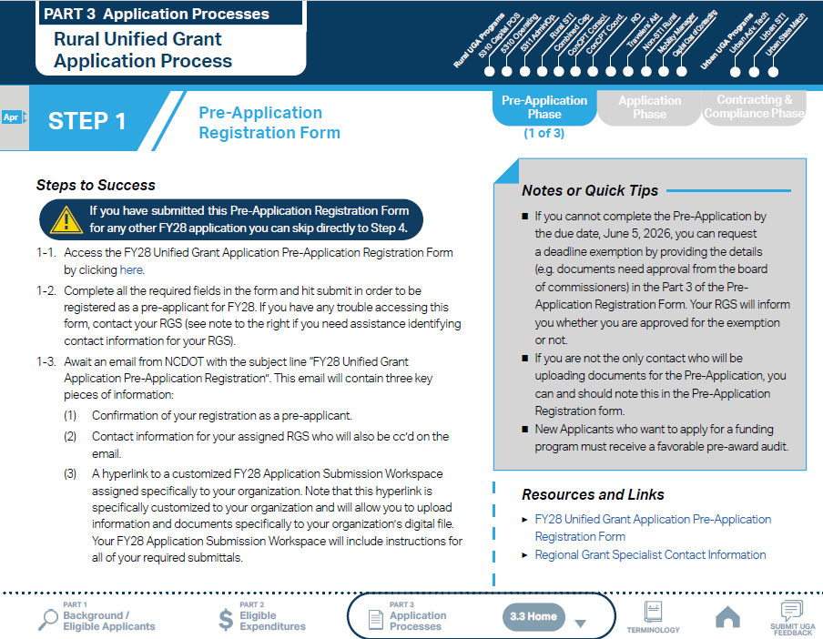
ncdot.gov
3.2 Unified Grant Application Process
1
Follow the steps provided for each funding program.
Notes:
Steps 1 through 3 are the Pre-Application Phase which prepares you with Pre-Application Registrations and Pre-Application Document submission.
Follow the steps provided for each funding program.

Slide 57
ncdot.gov
3.2 Unified Grant Application Process
1
Follow the steps provided for each funding program.
2
Make sure you check Notes or Quick Tips.
Notes:
Notes and Quick Tips as well as Resources and Links are provided for each step to assist you.

Slide 58
ncdot.gov
3.2 Unified Grant Application Process
1
Follow the steps provided for each funding program.
2
Make sure you check Notes or Quick Tips.
3
Click hyperlinks under Resources and Links for more resources.

Slide 59
ncdot.gov
3.2 Unified Grant Application Process
1
Follow the steps provided for each funding program.
2
Make sure you check Notes or Quick Tips.
3
Click hyperlinks under Resources and Links for more resources.
4
Refer to the general timeframe for completing the step. Refer to Part 3.1 for the Overall Program Timeline.
Notes:
The general timeframe for completing the step is noted to the left of the step name.

Slide 60
ncdot.gov
3.2 Unified Grant Application Process
1
Follow the steps provided for each funding program.
2
Make sure you check Notes or Quick Tips.
3
Click hyperlinks under Resources and Links for more resources.
4
Refer to the general timeframe for completing the step. Refer to Part 3.1 for the Overall Program Timeline.
5
Use Funding Program panel to see the Grant Application Process for other programs.
Notes:
Funding Programs panel on the upper right corner are linked to the Fund-Specific Grant Application Processes for other programs.

Slide 61
ncdot.gov
3.2 Unified Grant Application Process
1
Follow the steps provided for each funding program.
2
Make sure you check Notes or Quick Tips.
3
Click hyperlinks under Resources and Links for more resources.
4
Refer to the general timeframe for completing the step. Refer to Part 3.1 for the Overall Program Timeline.
5
Use Funding Program panel to see the Grant Application Process for other programs.
6
Use navigation box to go back to Part 3 or 3.3 Home.

Slide 62
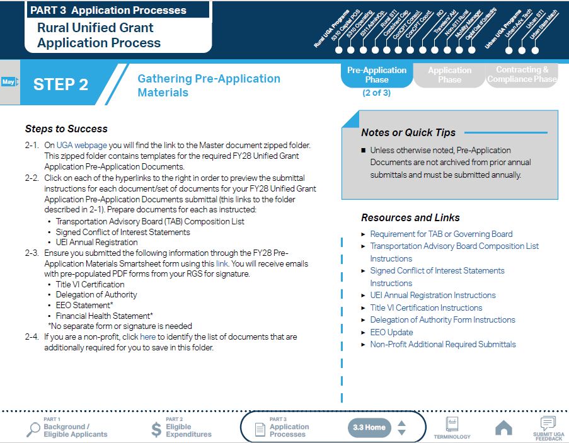
ncdot.gov
3.2 Unified Grant Application Process
Note: UGA process incorporates Smartsheet forms to replace some of the Pre-Application documents. Click the hyperlink to access the Smartsheet form.
Notes:
UGA process incorporated Smartsheet forms to replace some of the Pre-application documents. Click the hyperlinks to access the Smartsheet forms.

Slide 63
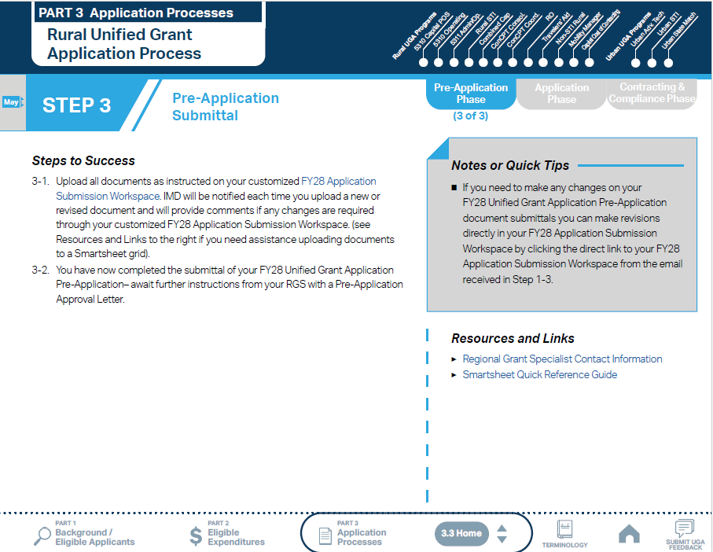
ncdot.gov
3.2 Unified Grant Application Process
Notes:
Once you get the Pre-Application Approval Letter, you may proceed to Step 4 Application Phase.

Slide 64
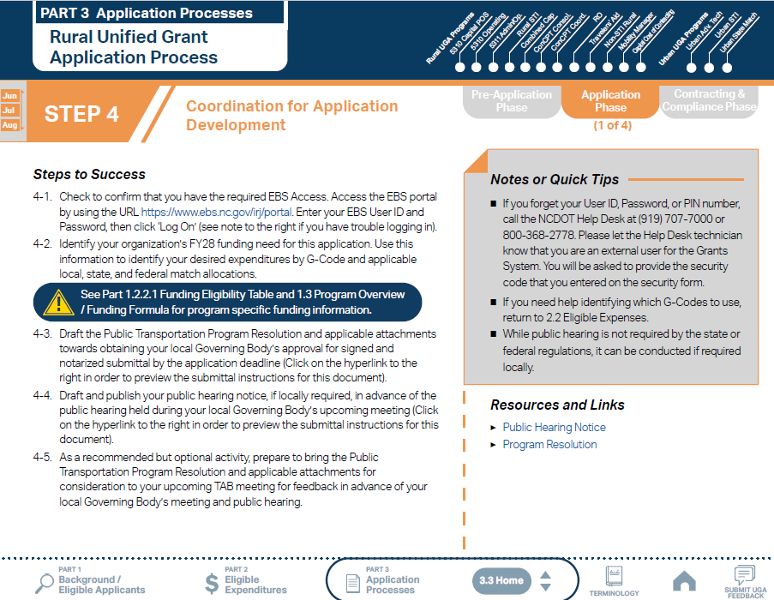
ncdot.gov
3.2 Unified Grant Application Process
Notes:
Steps 4 through 7 are Application phase where you can prepare documents that require a board approval.

Slide 65
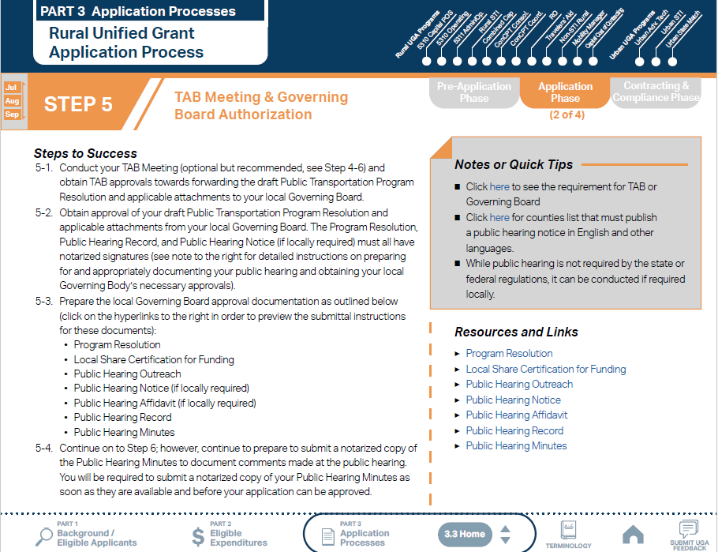
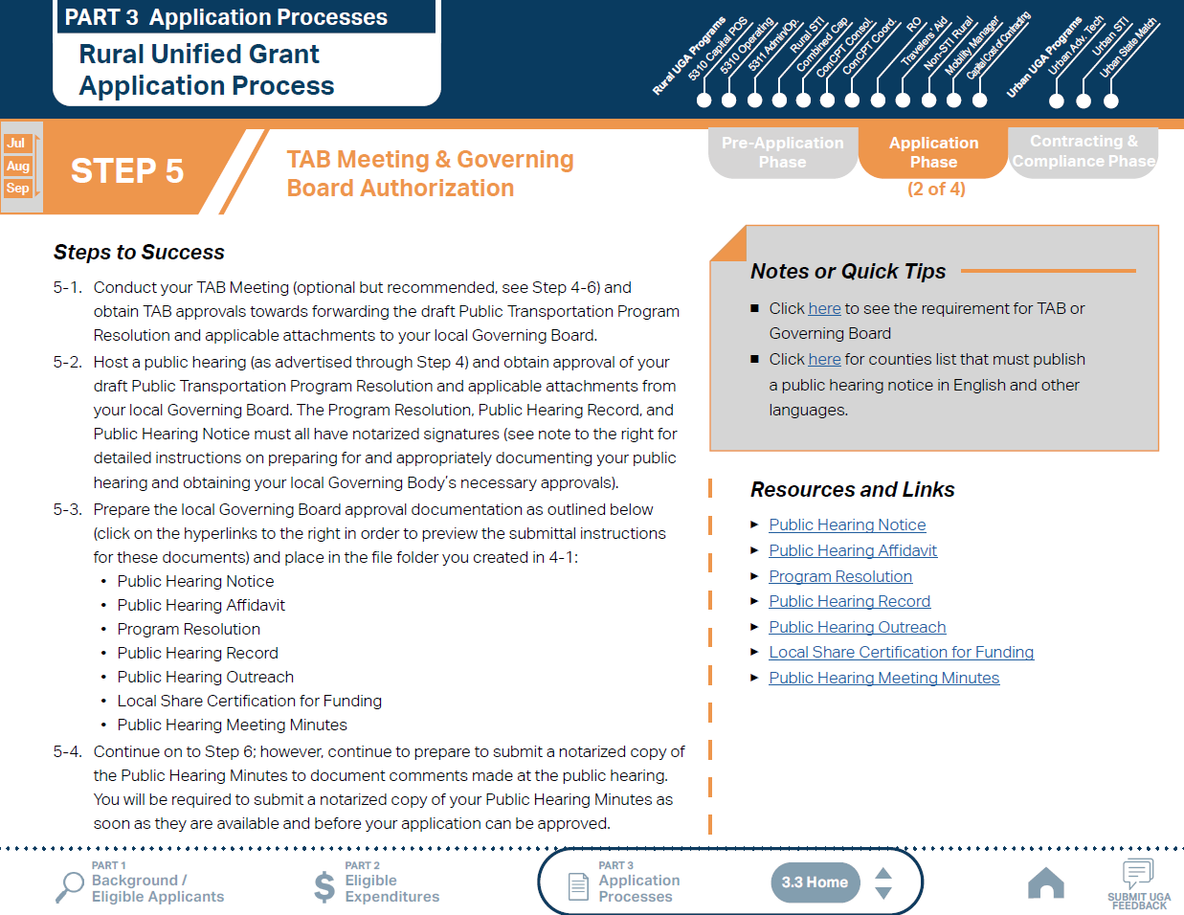
ncdot.gov
3.2 Unified Grant Application Process
Notes:
Each sub-steps lists all the documents required to submit. Refer to Resources and Links for more guidance on each document.

Slide 66
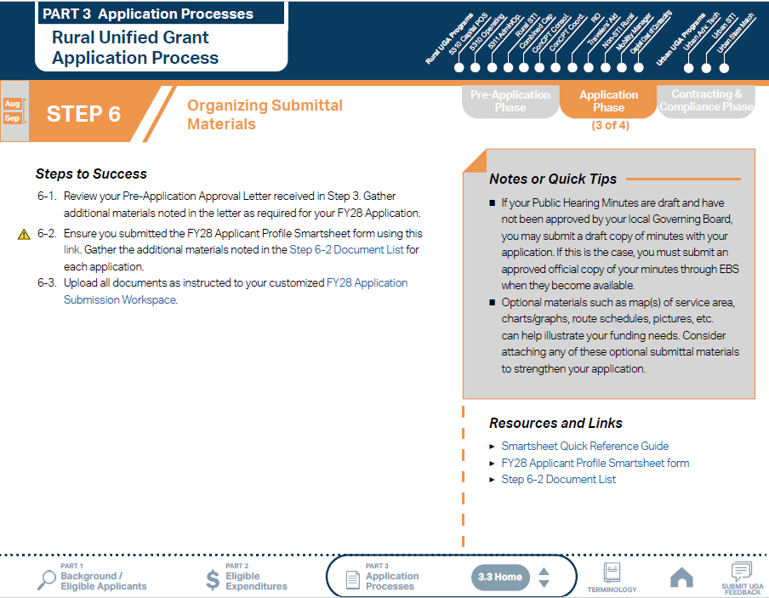
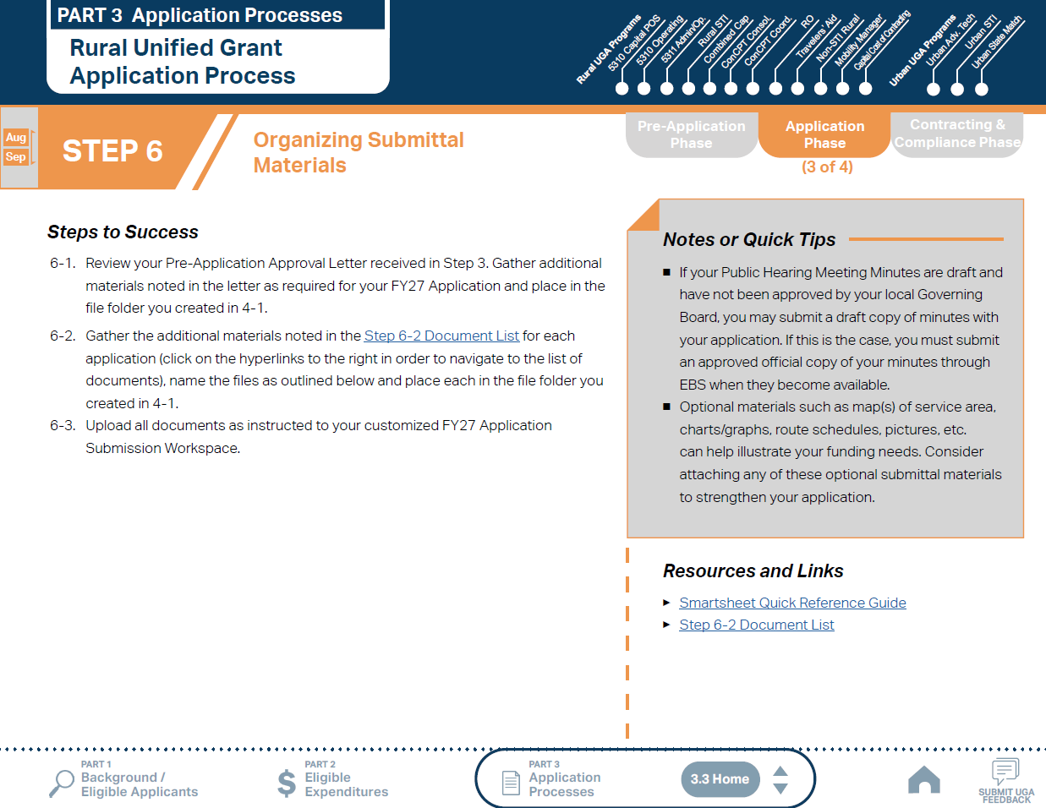
ncdot.gov
3.2 Unified Grant Application Process

Slide 67
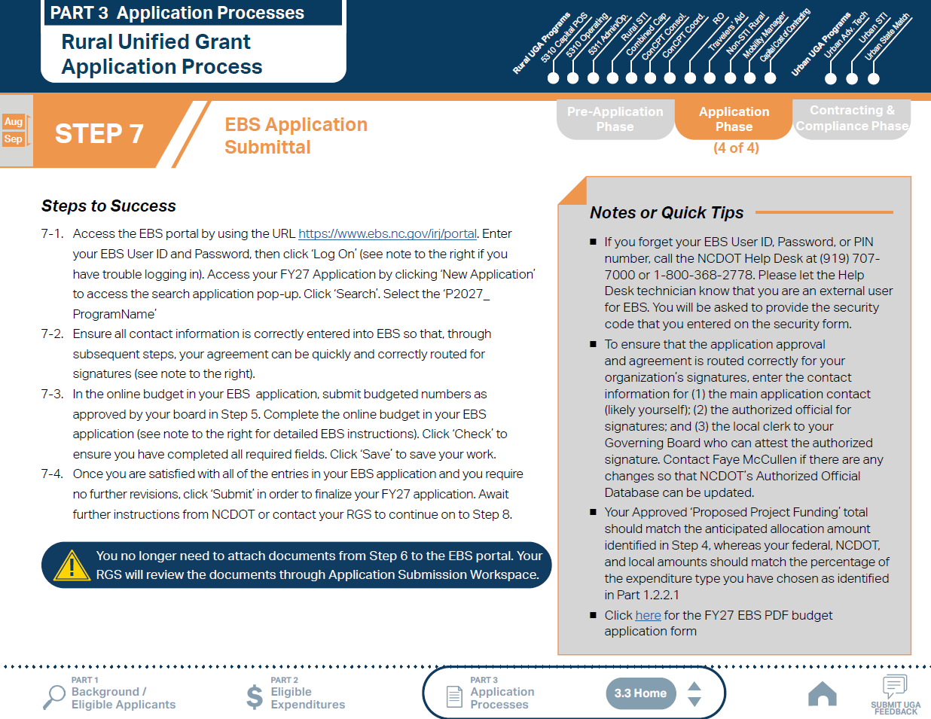
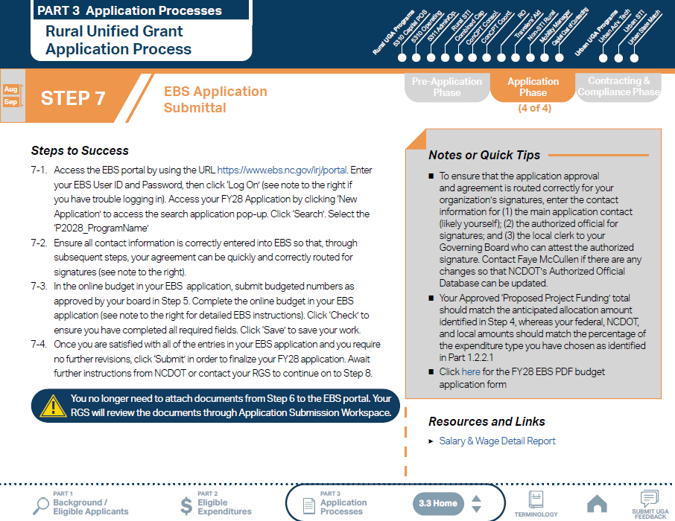
ncdot.gov
3.2 Unified Grant Application Process
Notes:
Applicants are instructed to submit all Application Phase documents to EBS portal.

Slide 68
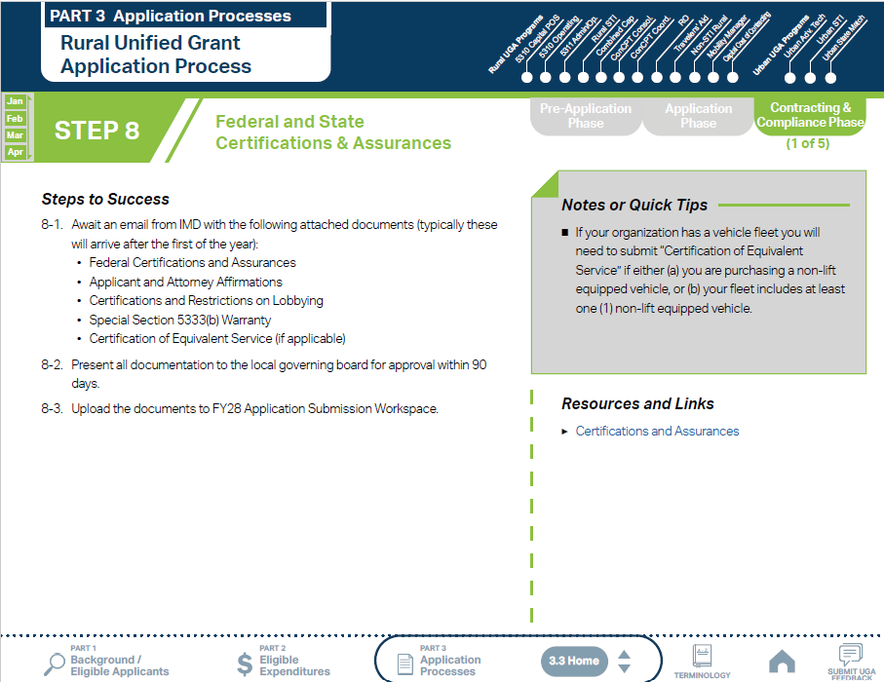
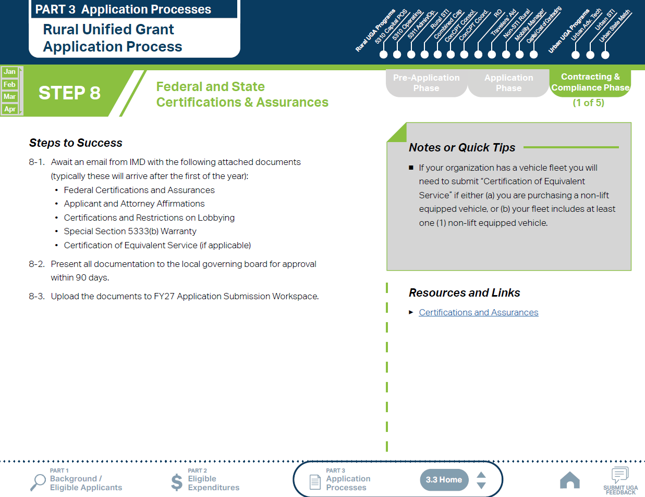
ncdot.gov
3.2 Unified Grant Application Process
Notes:
Step 8 through 12 are Contract & Compliance phase where you can submit compliance documents and claims after fund expenditure.
Federal and State Certification & Assurances are available after the first of the year. Once you receive the document through email, you adopt all documentation and upload to EBS.

Slide 69
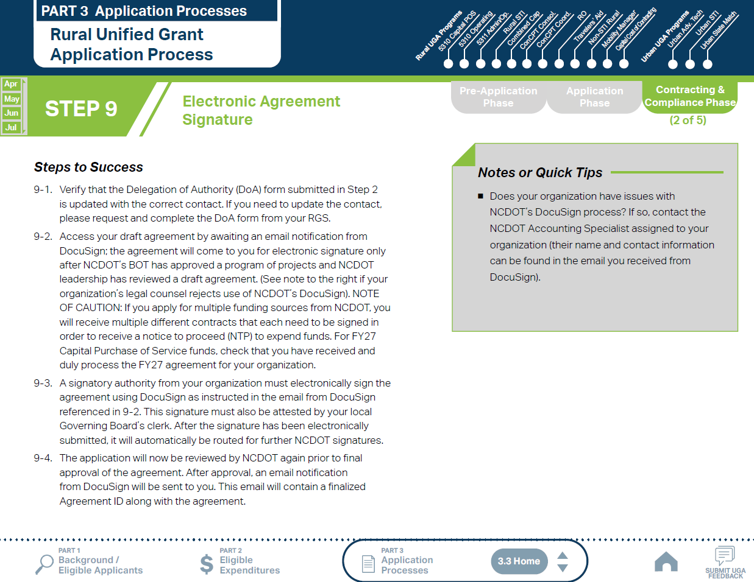
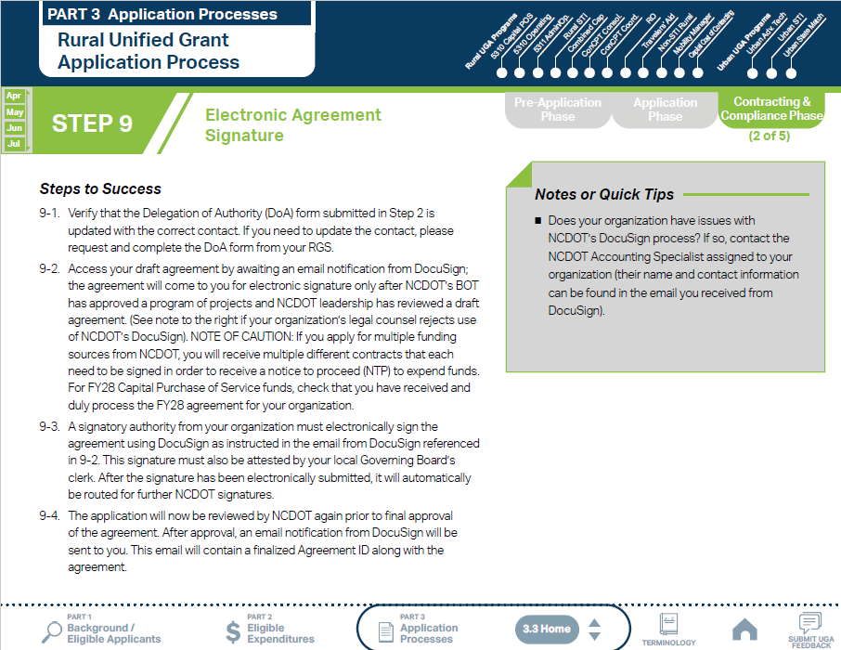
ncdot.gov
3.2 Unified Grant Application Process
Notes:
Through Step 9 you will electronically sign the agreement using DocuSign.

Slide 70
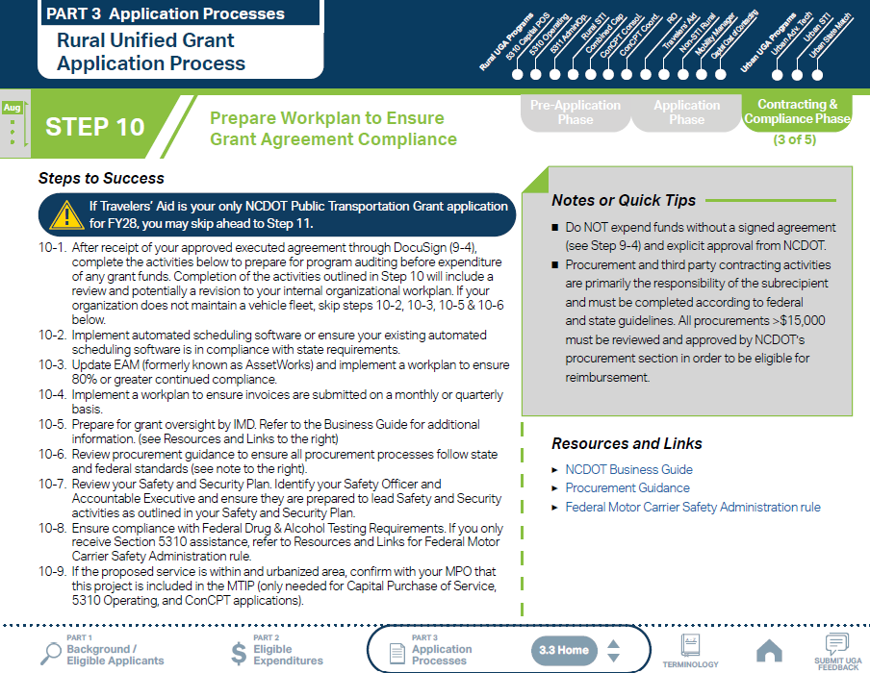
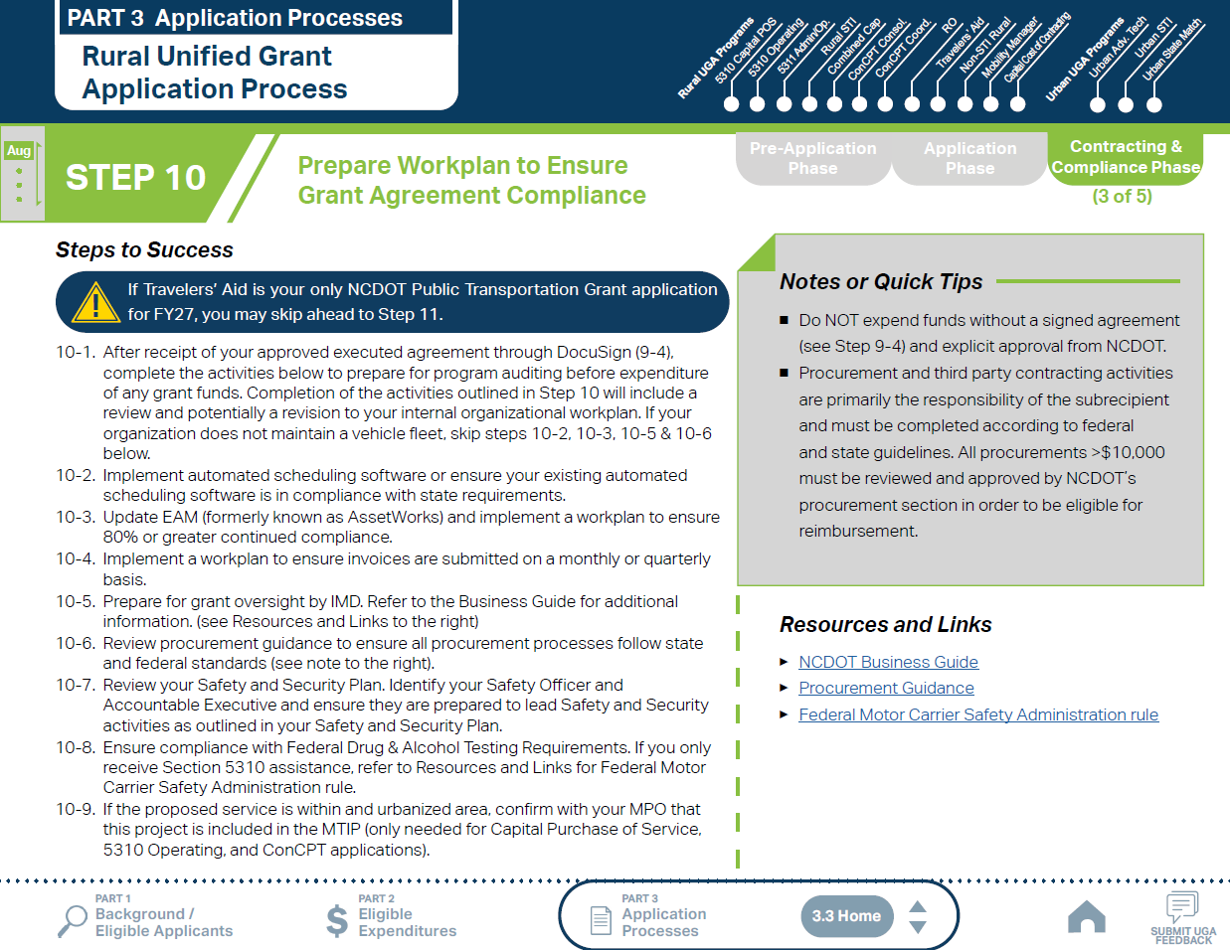
ncdot.gov
3.2 Unified Grant Application Process
Notes:
Step 10 guides you to ensure your compliance with federal and state requirements.

Slide 71
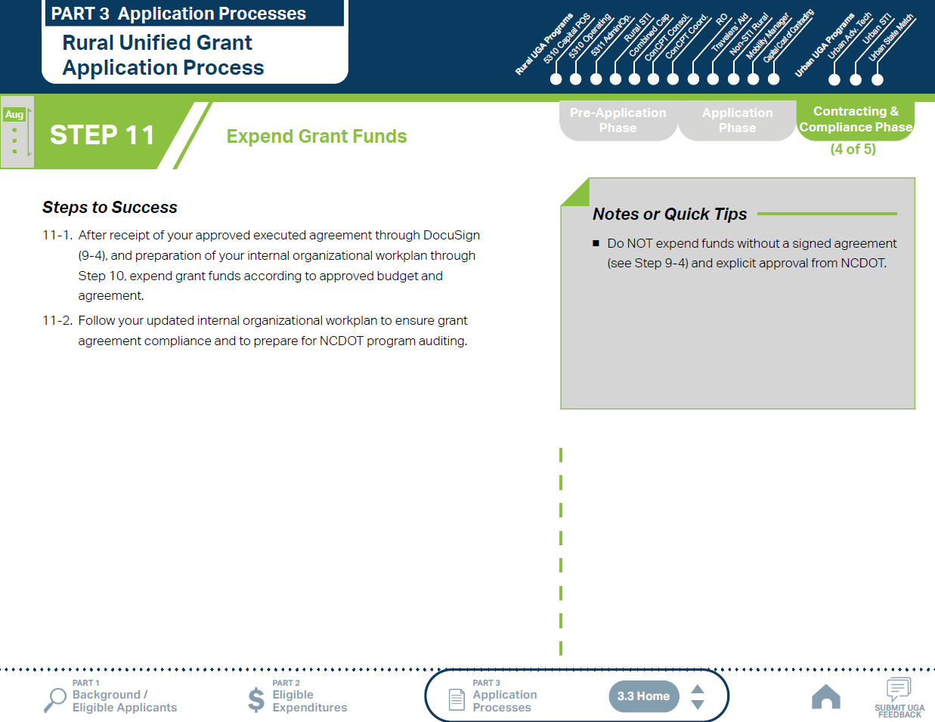
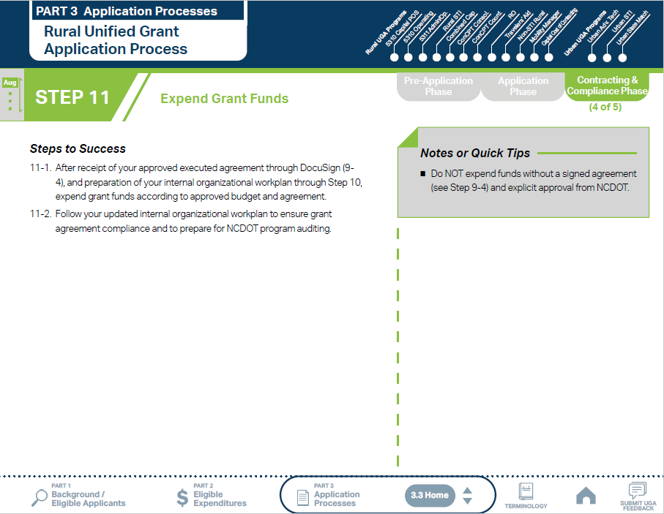
ncdot.gov
3.2 Unified Grant Application Process
Notes:
After Step 9 and Step 10, you can spend grant funds.

Slide 72
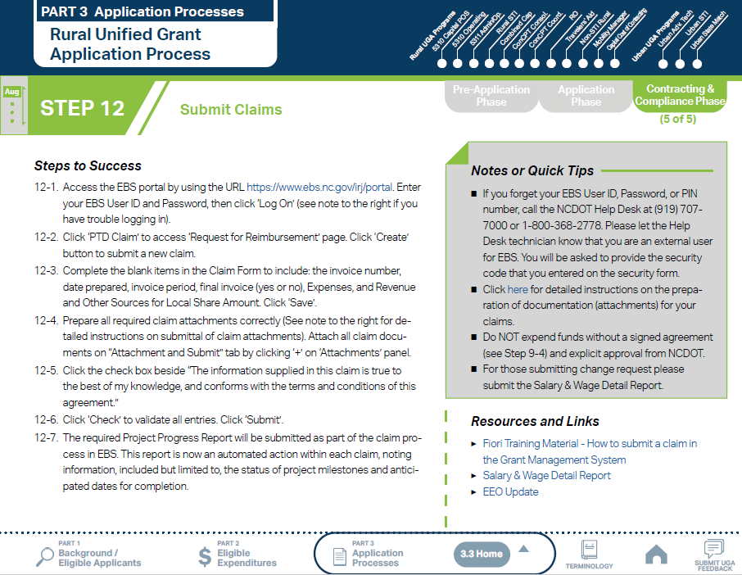
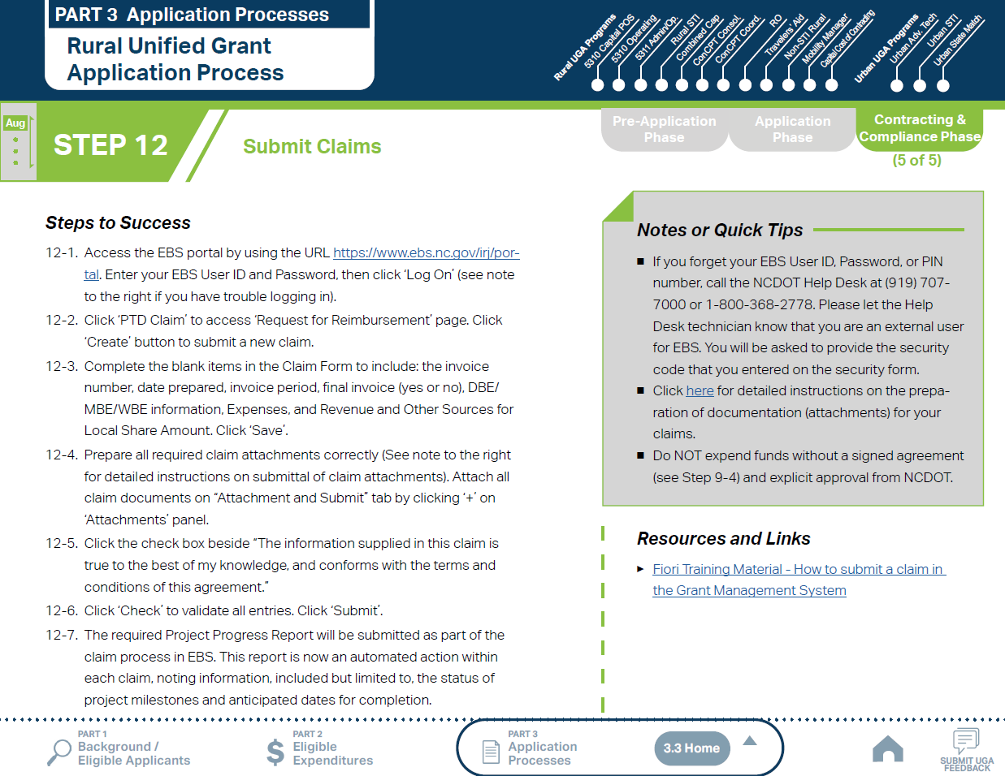
ncdot.gov
3.2 Unified Grant Application Process
Notes:
Follow step 12 to submit claims

Slide 73
ncdot.gov
3.3 FY2028 Master Documents
Pre-Application Phase Documents
Application Phase Documents
Transportation Advisory Board (TAB) Composition List
Signed Conflict of Interest Statements
UEI Annual Registration
Title VI Certification*
Delegation of Authority Form*
Equal Employment Opportunity Statement*
Financial Health Statement*
FY28 Applicant Profile Form
Program Resolution
Local Share Certification for Funding
Public Hearing Outreach
Public Hearing Notice (if locally required)
Public Hearing Affidavit (if locally required)
Public Hearing Record
Public Hearing Minutes
* Submit through FY28 Pre-Application Materials Smartsheet form
Notes:
Documents on the Pre-Application Phase Documents list are universal to cover all programs except for urban programs
Documents marked with an asterisk must be submitted through Smartsheet. Links and instructions are provided in the UGA.
Note that UEI Annual Registration is critical; a 5311 contract will not be issued if UEI is not verified and active
Applicants often think about these funds in two buckets: those funds requiring more board coordination/scheduling and those that may require lesser coordination (depending on organizational requirements)

Slide 74
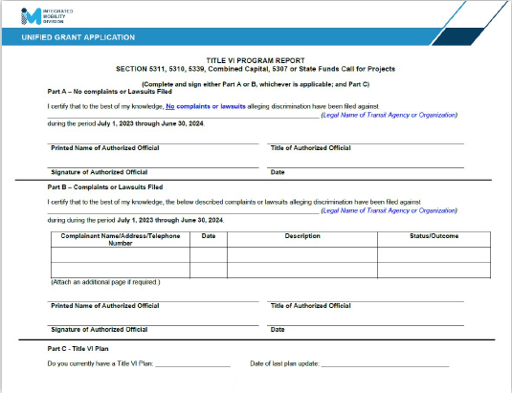
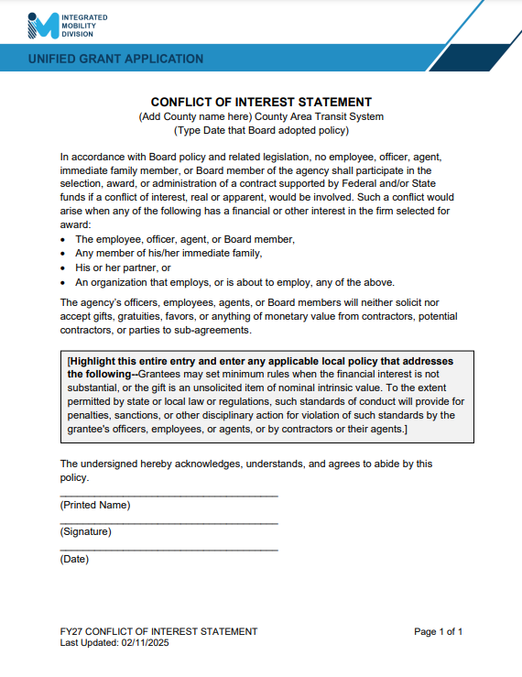
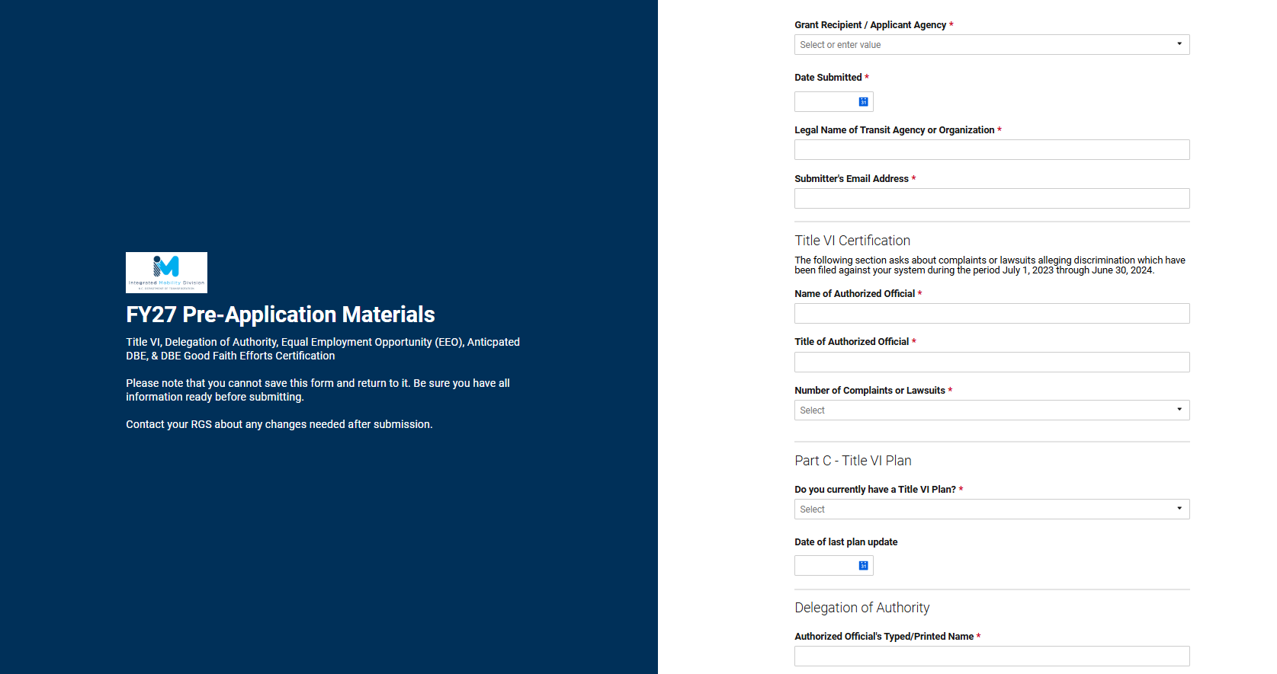
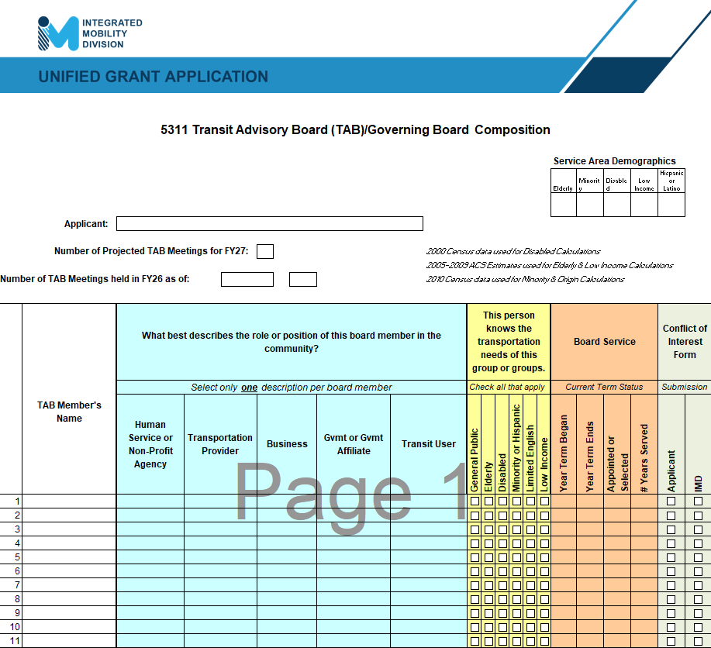
ncdot.gov
3.3 FY2028 Master Documents
Pre-Application Phase Documents
Transportation Advisory Board (TAB) Composition List
Signed Conflict of Interest Statements
UEI Annual Registration
Title VI Certification*
Delegation of Authority Form*
Equal Employment Opportunity Statement*
Financial Health Statement*
* Submit through FY28 Pre-Application Materials Smartsheet form
Notes:
Here are some basic supporting documents for applicants to gather for application submittal
Signed Conflict of Interest forms from TAB/Governing Board members are an annual requirement and must be submitted to consider an application complete
Some of the Pre-Application Phase documents require submission through Smartsheet. Refer to UGA Guidance for the links to the combined Pre-Application Materials Smartsheet form.
DBE Certification Form
EEO Form
Title VI Certification
Delegation of Authority Form
Anticipated DBE/MBE/HUB Vendor Award
Please note that you cannot save this form and return to it. Be sure you have all information ready before submitting.
Contact your RGS about any changes needed after submission.

Slide 75
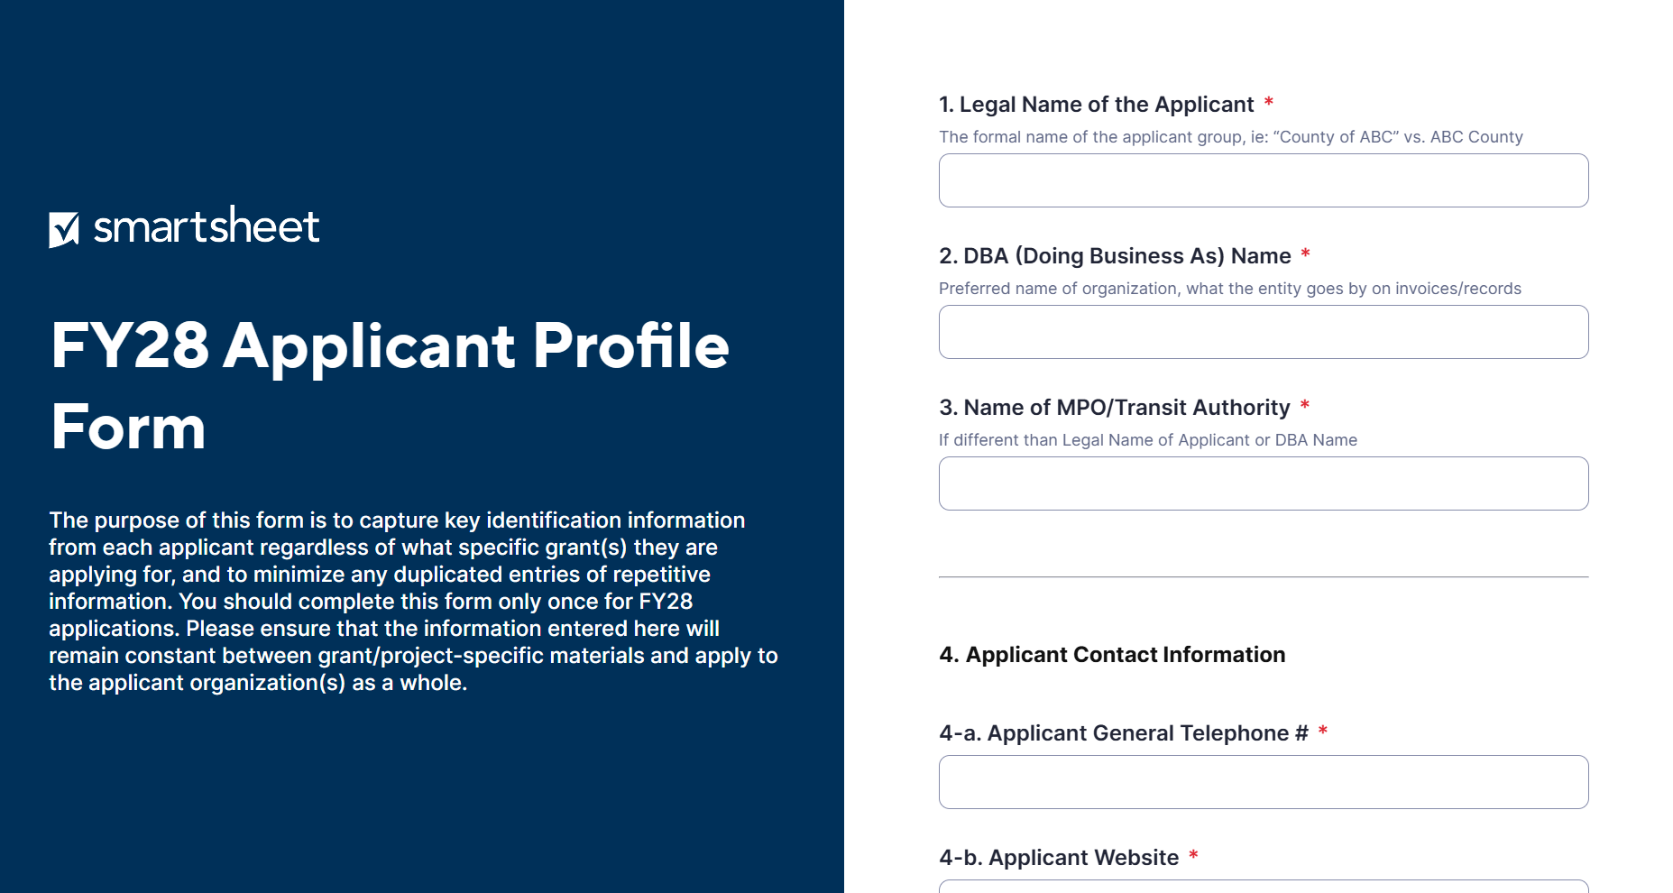
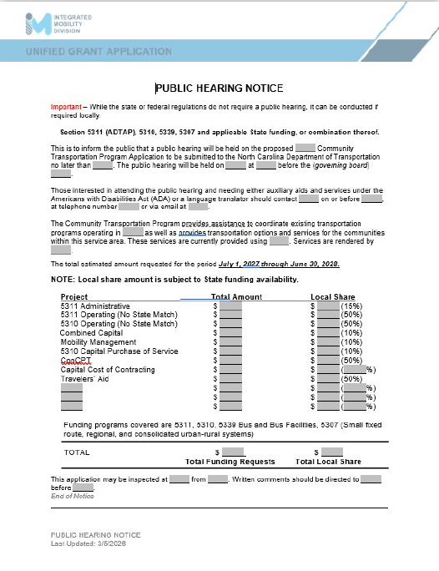
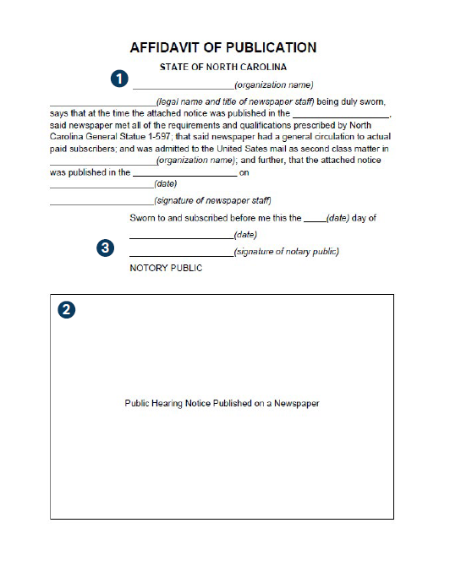




ncdot.gov
3.3 FY2028 Master Documents
Application Phase Documents
FY28 Applicant Profile Form
Program Resolution
Local Share Certification for Funding
Public Hearing Outreach
Public Hearing Notice (if locally required)
Public Hearing Affidavit (if locally required)
Public Hearing Record
Public Hearing Minutes
Notes:
Some master documents require additional coordination through a scheduled board meeting
A copy of board meeting minutes reflecting each funding source applied for are required as supporting documentation for the combined resolution

Slide 76
ncdot.gov
3.4 Section 5311 Program Submittals
5311 Designee Certification Form (due FY28)
Vehicle Insurance Certification (required)
Insurance Auto Schedule (required)
Job Description (if changed) – as applicable
Retail Estimate(s) or Proposal(s) – as applicable
Deviated Fixed Route Material – as applicable
Cost Allocation/Indirect Cost Plan – as applicable
Indirect Cost Rate Verification – as applicable
Facility Insurance Verification – as applicable
Vehicle Lease Agreement – as applicable
Third Party Provider Contract – as applicable
Rental Lease Agreement – as applicable
Software Lease Agreement – as applicable
Unified Application Checklist
Notes
Notes:
Section 5311 is an important funding source for rural transportation systems
In order to access 5311 funds, eligible applicants must include these submittals along with their application as applicable for desired expenditures for that fiscal year.
Facility Insurance Verification Certificate – is a required supplemental document submission for applicants that operate out of facilities with federal funding involved

Slide 77
ncdot.gov
3.4 Section 5311 Program Helpful Hints
Quick Tips
Budget amount distributed to systems by assigned Regional Grant Specialist
Amount can be used as all Admin, all Operating, or Combination
State does not participate in Operating budgets
Administrative salary reimbursement correlation to public transportation
Lease and/or service agreements are required documents
Notes:
Budget amount distributed to systems by assigned Regional Grant Specialist
Amount can be used as all Admin, all Operating, or combination
If 5311 funds are used as both Admin & Operating, there is a ceiling on the total amount allowed. This ceiling will be published in the guidance for the 5311 Call for Projects
State does not participate in Operating budgets
Job descriptions are required for new positions added to the grant or if a change in job duties
If an Admin position is less than 100% assigned to Transportation, the amount of salary must be requested accordingly, i.e., Administrative Assistant, 50% Transportation and 50% Operations, the 50% for Operations cannot be requested with Admin dollars
Lease and/or service agreements are required documents for rent, equipment, professional or contracted services, uniform rental, etc.…

Slide 78



ncdot.gov
3.4 Combined Capital Program Submittals
Combined Capital Application
Fleet Replacement Plan (required)
Independent Cost Estimate (ICE) Form – as applicable
Estimate(s) or Proposal(s) – as applicable
NEPA Information Form (Specified G-codes)
Unified Application Checklist
Notes:
Combined Capital is an important funding source for rural & small urban transportation systems
In order to access Combined Capital funds eligible applicants must include these submittals along with their application as applicable for desired expenditures for that fiscal year
Only need specific quotes/estimates if requesting items such as computers, furniture, fencing, etc. (items not on the state contract)

Slide 79
ncdot.gov
3.4 Combined Capital Program Helpful Hints
Quick Tips
Useful life miles criteria for replacement (Circular 5010.E)
Procurements over $15,000 require procurement checklist, review, and approval from IMD
Elaborate as much as possible on the application questions requiring a written answer
Regional Grant Specialists will be working with transit systems on determining how many and which vehicles will be in line for replacement in FY28
Eligible for electric vehicles (EV) if systems have initiated a feasibility study and EV infrastructure design OR already have charging infrastructure in place. Charging infrastructure must be used for transit vehicles only.
ITRE pre-approval no longer required
Notes:
Vehicles must meet useful life miles criteria for replacement by June 30, 2022. Vehicle useful life mileage is 100,000 miles for most vehicles. The useful life mileage is outlined in Circular 5010.E, that threshold will continue
Procurements over $10,000 require procurement checklist, review, and approval from IMD
Elaborate as much as possible on the application questions requiring a written answer
Regional Grant Specialists will be working with transit systems on determining how many and which vehicles will be in line for replacement in FY26
ITRE pre-approval no longer required

Slide 80

ncdot.gov
3.4 Section 5310 Operating Program Submittals
5310 Application - Operating
MPO/RPO Letter(s) of Support
Locally Coordinated Human Service Plan
Unified Application Checklist
Notes:
Section 5310 is an important funding source for rural & small urban transportation systems
In order to access Section 5310 funds, eligible applicants must include these submittals along with their application as applicable for desired expenditures for that fiscal year

Slide 81
ncdot.gov
3.4 Section 5310 Operating Program Helpful Hints
Quick Tips
Goal: Seniors and Individuals with Disabilities
Senior = an individual 65 years or older
Section 5310 funding is allocated based on systematic set of project scoring criteria
Funding is not guaranteed
Letter of Support from the applicant’s MPO/RPO
Limited eligibility of operating expenditures
Notes:
The Section 5310 Program circular (9070.1G) defines a Senior as an individual 65 years or older
Section 5310 funding is allocated based on systematic set of project scoring criteria
Approved funding amount will depend upon the number of elderly and disabled population in each county and number of applicants within each region. Elaborate as much as possible on questions requiring a written answer
The Statewide Locally Coordinated Plan outlines 5310 project approval guidelines which IMD will follow when determining which projects are approved for funding
Funding is not guaranteed for any project, and it is possible approved projects may receive less funding than requested
5310 projects require a Letter of Support from the applicant’s MPO/RPO and must be able to show the service is not primarily in an urban area
Salaries and benefit expenses along with motor fuel, oils and lubricants, etc.…are not eligible items for 5310 funding

Slide 82
ncdot.gov
3.4 5310 Capital Purchase of Service Program Submittals
5310 Application - Capital Purchase of Service
MPO/RPO Letter(s) of Support
Locally Coordinated Human Service Plan
Third-Party Contract(s), Estimate(s) or Proposal(s) – as applicable
Unified Application Checklist
Notes:
Capital Purchase of Service is an important funding source for other agencies
In order to access Capital Purchase of Service funds, eligible applicants must include these submittals along with their application as applicable for desired expenditures for that fiscal year

Slide 83
ncdot.gov
3.4 5310 Capital Purchase of Service Program Helpful Hints
Quick Tips
Non-transit agencies to apply for funds to purchase service from a public or private provider
Goal: Seniors and Individuals with Disabilities
Contracts/Memorandums of Agreement for service are required
Senior as an individual 65 years or older
Section 5310 funding is allocated based on systematic set of project scoring criteria
Locally Coordinated Human Services Transportation Plan
Letter of Support from the applicant’s MPO/RPO
Reimbursements are made on a cost-per-trip basis
Notes:
Contracts/Memorandums of Agreement for service are required
The Statewide Locally Coordinated Plan outlines 5310 project approval guidelines which IMD will follow when determining which projects are approved for funding
Funding is not guaranteed for any project, and it is possible approved projects may receive less funding than requested
Section 5310 funding is allocated based on systematic set of project scoring criteria
5310 projects require a Letter of Support from the applicant’s MPO/RPO and must be able to show the service is not primarily in an urban area
Applications for purchase of service funding from applicants who are not 5311 funded grantees must include:
A Memorandum of Understanding between the applicant and a 5311 funded transit provider to be the sole provider of service; or
Proof the applicant completed a compliant federal procurement for private transportation providers that provide shared ride service
Reimbursements are made on a cost-per-trip basis

Slide 84

ncdot.gov
3.4 5310 Capital Purchase of Service Contract Template
NOTE: THIS IS A TEMPLATE - ANOTHER LOCAL TEMPLATE COULD BE USED IF DESIRED
Notes:
NCDOT IMD has a template which can be used for Capital Purchase of Service contracts
Another local template could be used if desired

Slide 85
ncdot.gov
3.4 Mobility Manager Program Submittals
Mobility Manager Application
Locally Coordinated Human Service Plan (MTIP)
MPO/RPO Letter(s) of Support
Job Description w/ % of Time Assigned
Letters of Support (Optional, agencies and/or client letters not MPO or RPO)
Pictures (Optional)
Charts and/or Graphs (Optional)
Route Schedules (Optional)
Marketing Plan (Optional)
Unified Application Checklist
Notes:
Funded through NCDOT’s oversight of Section 5310 federal funds
A job description is required for the Mobility Manager application. Include the percent of time assigned to each task
Like other 5310 programs, Mobility Manager applications require a Letter of Support from the applicant’s MPO/RPO and must be able to show the service is not primarily in an urban area
Elaborate as much as possible on application questions requiring a written answer

Slide 86
ncdot.gov
3.4 Mobility Manager Program Helpful Hints
Quick Tips
Multi-county participation no longer required
1 position only per applicant
Section 5310 funding is allocated based on systematic set of project scoring criteria
The progress report submitted quarterly or with each claim
Not eligible for marketing and general administrative duties
Matching funds are 80% federal, 10% state, and 10% local
Statewide Locally Coordinated Plan
Notes:
Multi-county participation no longer required
Mobility Manager grant is for 1 position only per applicant
Section 5310 funding is allocated based on systematic set of project scoring criteria
The progress report submitted quarterly or with each claim must include details on number of clients served, meeting attended, presentations made to support the activities listed in the application. Sign-in sheet or meeting agenda must be included
Marketing and general administrative duties are not eligible activities for the Mobility Manager position
Matching funds are revised to 80% federal, 10% state, and 10% local
The Statewide Locally Coordinated Plan outlines 5310 project approval guidelines which IMD will follow when determining which projects are approved for funding
Mobility Manager applications will only be funded if there are funds available after other needs have been met

Slide 87


ncdot.gov
3.4 Rural State Operating Program Submittals
Rural State Operating Grant (RO) Application
Unified Application Checklist
Notes:
RO is an important funding source for those specifically designated as eligible

Slide 88
ncdot.gov
3.4 Rural State Operating Program Helpful Hints
Quick Tips
Purpose: To extend general transportation opportunities and increase ridership in our rural areas
The funding formula is 50% based on individuals in poverty and 50% based on service hours
Local match is 50%. ROAP funds are eligible for local match
Eligible systems are pre-identified, allocations will be provided by RGS
Notes:
Eligible recipients are either a Small Fixed Route System, Regional System, or Urban/Rural Consolidated System and are identified in the program overview material
The purpose of the RSO funds is to extend general transportation opportunities and increase ridership in our rural areas
A funding formula was created for equitable distribution of the operating funds to all systems that qualify. The funding formula is 50% based on individuals in poverty and 50% based on service hours
Local match is 50%. ROAP funds are eligible for local match

Slide 89



ncdot.gov
3.4 Travelers’ Aid Program Submittals
Project Funding Justification Form
Project Description
Local Funding Commitment Form
Project Analysis Form
Unified Application Checklist
Notes:
Travelers' Aid is an important funding source for public transportation in NC
In order to access Travelers' Aid funds eligible applicants must include these submittals along with their application as applicable for desired expenditures for that fiscal year

Slide 90
ncdot.gov
3.4 Travelers’ Aid Program Helpful Hints
Quick Tips
Provide intercity bus and/or train tickets for disadvantaged individuals, victims of domestic violence, and stranded travelers in need of transportation to other locations in times of distress.
Mission: Advance and support network of human service providers assisting individuals and families in crisis
50% State and 50% Local funding
Notes:
NCDOT assists in funding Travelers’ Aid programs around the state. The overall purpose of the Travelers’ Aid Program is to provide intercity bus and/or train tickets for disadvantaged individuals, victims of domestic violence, and stranded travelers in need of transportation to other locations in times of distress
These programs provide assistance to homeless individuals or families who are seeking relocation to safe, stable, and supportive homes. Issues include, but are not limited to:
Escaping domestic violence
Experiencing a major medical crisis
Job Loss
Homelessness
The mission of the Travelers’ Aid program is to advance and support a network of human service providers committed to assisting individuals and families who are in transition or crisis and are disconnected from their support systems. Travelers’ Aid programs consist of a diverse group of human service nonprofit organizations and a network of transportation providers
Eligible applicants are private non-profit organizations; public transportation providers, including private operators of public transportation services; and local governmental authorities
50% State and 50% Local funding

Slide 91


ncdot.gov
3.4 ConCPT Program Submittals
ConCPT Funds Application
IMD Approved Billing Rate (for Coordination grant)
MOA
Letters of Support (Optional)
Pictures (Optional)
Charts and/or Graphs (Optional)
Route Schedules (Optional)
Marketing Plan (Optional)
Unified Application Checklist
Notes:
ConCPT is an important funding source funded by the State
In order to access ConCPT funds, eligible applicants must include these submittals along with their application as applicable for desired expenditures for that fiscal year

Slide 92
ncdot.gov
3.4 ConCPT Program Helpful Hints
Quick Tips
State Funding
Two purposes: A) encourage transit systems to consolidate into a single transit system and B) encourage coordination between providers for longer-distance trips spanning multiple (3 or more) service areas
$1.5M in funding: $750,000 for each program
Must run five days per week to be eligible
Coordination amongst partner systems must include explicit billing coordination
Separate application components for ConCPT CN and ConCPT CO
Notes:
Funding originally provided by the North Carolina legislature in August 2017. Continued availability of funds dependent on state legislative authorization.
Funds are for two purposes: 1) encourage transit systems to consolidate into a single transit system and 2) encourage coordination between providers for longer-distance trips spanning multiple (3 or more) service areas. Expected results are to maximize resources, gain efficiencies, and increase access to public transportation
Ex. Consolidation: Hyde-Tyrrell
Ex. Coordination: Down East Express and Ridge Runner
Eligible applicants must be sub-recipients of Federal transit funds through the NCDOT Integrated Mobility Division or directly from the Federal Transit Administration
$1.5M in funding: $750,000 for each program
Coordination service must run 5-days per week to be eligible
A billing scenario between lead system and participating systems must be established but each system benefits with increased ridership, trips counted on each leg, and revenues earned as usual
Application is divided between programs, only complete applicable part

Slide 93
ncdot.gov
3.4 Section 5303 Program Submittals and Helpful Hints
Unified Planning Work Program (UPWP)
UPWP Task Summary Table
PWP Approval Resolution
FTA Task Narrative Table
DBE Anticipated Contracting Opportunities Form
Resolution Certifying of the Transportation Planning Process
Quick Tips
Allocation table uses same criteria as 2022, draft and final UPWP submittal schedules follow Transportation Planning Division Schedule
Draft and Final UPWP schedule outlined in Program Overview
Notes:
5303 is an important funding source funded by the FTA for transit planning
In order to access 5303 funds, eligible applicants must include these submittals along with their application as applicable for desired expenditures for that fiscal year

Slide 94
ncdot.gov
3.4 Urban Advanced Technology Program Submittals and Helpful Hints
Advanced Technology Application
Program Resolution
Current Projects
FY 28 Budget_3-Year Plan_Quarterly Report_Cash Flow
Memorandum of Understanding for the Project
Urban Advanced Technology Project Application Requirements Form
Cover Letter
Unified Application Checklist
Quick Tips
Eligible projects may include items such as:
Technologies designed to enhance safety and customer experience
Technologies designed to improve operational efficiency
Technologies designed to reduce the impacts of COVID-19
Camera systems
2. Up to 90% State and 10% Local funding
Notes:
IMD administers the Urban Advanced Technology grant available to the urban transit systems of North Carolina on a competitive basis.
Funding is awarded to projects that can be completed within the period of performance and are ready to move forward as soon as the project period of performance begins.

Slide 95
ncdot.gov
3.4 Urban STI / Rural STI Program Submittal
STI Urban (Rural STI) State Match Request Form
TrAMS Application for the project showing any Federal Funds that will be used
Board of Transportation Agenda
Local Funding Commitment
Feasibility Study (facility projects)
Facility Insurance Verification (facility projects)
Vehicle Purchase Orders – as applicable
5311 Designee Certification Form (FY28 – FY32)
Unified Application Checklist
Notes:
STI is an important funding source for transportation systems. In order to access STI funds, eligible applicants must be approved through STI and include these submittals along with their application as applicable for desired expenditures for that fiscal year
Access to expansion vehicles and facilities
In the event of no state funding, applicant should prepare to supply the full 20% local match

Slide 96
ncdot.gov
3.4 Urban STI / Rural STI Program Helpful Hints
Quick Tips
Eligible Projects : expansion vehicles, facility, fixed guideway
Must be identified through NCDOT’s Prioritization Process, IMD application required for approved year
Quick Tips
Notes:
STI is an important funding source for transportation systems. In order to access STI funds, eligible applicants must be approved through STI and include these submittals along with their application as applicable for desired expenditures for that fiscal year
Access to expansion vehicles and facilities
In the event of no state funding, applicant should prepare to supply the full 20% local match

Slide 97
ncdot.gov
3.4 Non-STI Rural Expansion Vehicle Program Submittals and Helpful Hints
Non-STI Rural Expansion Vehicle application
5311 Designee Certification Form (FY28 – FY32)
Unified Application Checklist
Quick Tips
Access for Rural Systems for funding for expansion vehicles
20% Local match
Available only if and after all capital needs have been fulfilled
Notes:
Access to rural expansion vehicles
Applicant should prepare to supply the full 20% local match
Funding is provided through this source only if and after all capital needs as assessed through other applications (Combined Capital) have been fulfilled

Slide 98
ncdot.gov
3.4 Capital Cost of Contracting Program Submittals and Helpful Hints
IMD Capital Cost of Contracting Toolkit
Service Contracts - as applicable
Vehicle Maintenance Contract - as applicable
Vehicle and/or Maintenance Lease Agreements - as applicable
Turnkey Contract - as applicable
Unified Application Checklist
Quick Tips
Sub-section of the State’s allocation of Section 5311 or 5339 funding
Current Section 5311 sub-recipients are eligible to apply
Only costs that are attributed to the privately owned assets by contractor are eligible for funding assistance
Notes:
Sub-section of the State’s allocation of Section 5311 or 5339 funding
Current Section 5311 sub-recipients are eligible to apply
Only costs that are attributed to the privately owned assets by contractor are eligible for funding assistance

Slide 99



ncdot.gov
3.5 Claim Submittal
Claims Cover Sheet (Signed)
Claims Reimbursement Letter (Signed)
Progress Report (Signed)
DBE Form (Signed)
Other backup documents (Invoices, receipts, etc.)
Notes:
Critical to submit a complete claims package to EBS in order to process a reimbursement as quickly as possible
Applicants must submit with each claim:
Claims Cover Sheet
Claims Cover Letter on organizational letterhead
Progress Report particular to the fund for which you’re submitting reimbursement
DBE Vendor Payments
Supporting Materials (Invoices, Salary Ledgers, etc.) to show what expenditures were made

Slide 100



ncdot.gov
3.5 Claim Submittal – Progress Report
(Progress Report Examples)
Notes:
Note that progress report templates are unique for different funding sources.

Slide 101
ncdot.gov
3.6 Final Notes
Incomplete or late applications may delay review and contracting.
Incomplete or late applications may result in an impact to funding amounts.
Systems must be in compliance to be eligible to receive funding.
Reminder: State funding may not be available for some programs.
Notes:
Incomplete or late applications may delay review and contracting
Incomplete or late applications may result in an impact to funding amounts
Systems must be in compliance to be eligible to receive funding
Reminder: State funding may not be available for some programs

Slide 102

ncdot.gov
3.6 Final Notes
Please provide feedback through the UGA feedback form

Slide 103

ncdot.gov
O
Questions?
Carolyn M. Freitag
Grants Administration Manager
Integrated Mobility Division
919-707-4676
cmfreitag@ncdot.gov
Kenetta Spence
Deputy Director of Finance and Grant Administration
Integrated Mobility Division
(919) 707-4673
kmspence1@ncdot.gov
Casondra L. Hamilton
Business Officer II
Public Transportation Division
919-707-2600
clhamilton@ncdot.gov
Notes:
Questions?

